Slide 1
Running CHEEREIO 1.3 A hands-on guide to nonlinear ensemble data assimilation and emissions estimation with GEOS-Chem
11th International GEOS-Chem meeting clinic
Drew Pendergrass
June 10, 2024

Slide 2
Table of contents
Introduction to ensemble data assimilation and CHEEREIO
Installing CHEEREIO and building your first ensemble
Selecting or adding observation operators
Running and debugging CHEEREIO
Postprocessing and data analysis tools

Slide 3
Table of contents
Introduction to ensemble data assimilation and CHEEREIO
Installing CHEEREIO and building your first ensemble
Selecting or adding observation operators
Running and debugging CHEEREIO
Postprocessing and data analysis tools

Slide 4
The bottom-up method of emissions estimation
Emissions factor
x
Activity level
=
Emissions
x
=
Emissions from electricity
Amount of electricity generated
Fuel type, scrubbers, etc.
+
=
Emissions from transportation
x
Vehicle type
+
Distance traveled
Emissions from other sectors
=
Total emissions
Bottom-up emissions are necessary but imperfect.
Observations can help quantify missing sources.
Notes:
Repeat for every pollutant and every source of each pollutant.

Slide 5
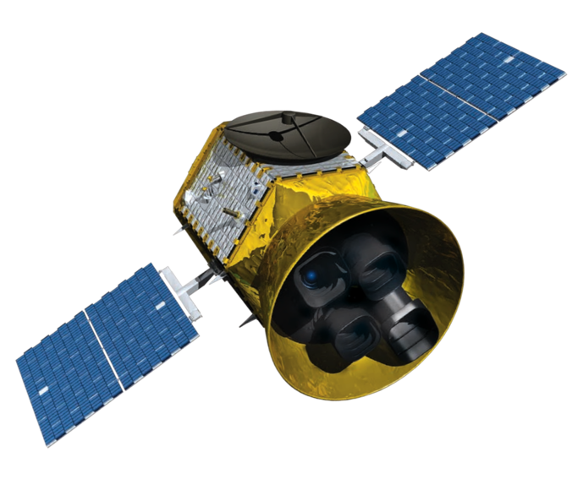
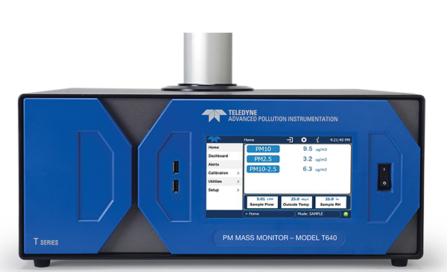
Data assimilation allows atmospheric models to incorporate observations
Assimilate
Remote sensing
Sunlight
Emissions and chemistry
corrected to match reality
Aerosols
and clouds
Transport
CHEMISTRY
Observe
Deposition
Anthropogenic and biogenic
emissions
Predict
Surface monitoring

Slide 6
CHEEREIO guesses emissions and compares model to observations
Real satellite measures
100 ppb NO_{x}…
If we emit 500 kg NO_{x} per hour…
… satellite would measure
75 ppb NO_{x}
… so truth is in between these two guesses
If we emit 1000 kg NO_{x} per hour…
… satellite would measure
150 ppb NO_{x}

Slide 7
Ensemble-based approaches are a relatively cheap way to handle linear and non-linear problems
No data assimilation
With Ensemble DA
Observations
Observations
Concentration
Concentration
Information from observations
accumulates with time
Base model
Base error
Ensemble of simulations
Time
Time

Slide 8
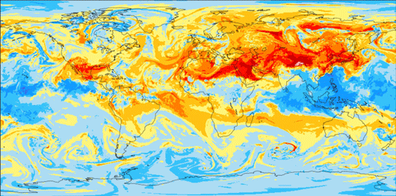
How ensemble chemical data assimilation works
…
…
Run a CTM for each
emission field
Generate n perturbations
to initial emissions
Generate n simulated 3D atmospheres, each reflecting different emissions
Apply observation operators (e.g. satellite averaging kernels)
…
Compare simulated observations to actual observations
…
Use ensemble spread to approximate prior error covariance matrix
Specify or calculate observational error covariance matrix

Slide 9
How ensemble chemical data assimilation works
…
…
Run a CTM for each
emission field
Weighting by covariance matrices, calculate optimal posterior emissions and/or concentrations
Generate n simulated 3D atmospheres, each reflecting different emissions
Rinse and repeat
Apply observation operators (e.g. satellite averaging kernels)
…
Compare simulated observations to actual observations
…
Use ensemble spread to approximate prior error covariance matrix
Specify or calculate observational error covariance matrix

Slide 10
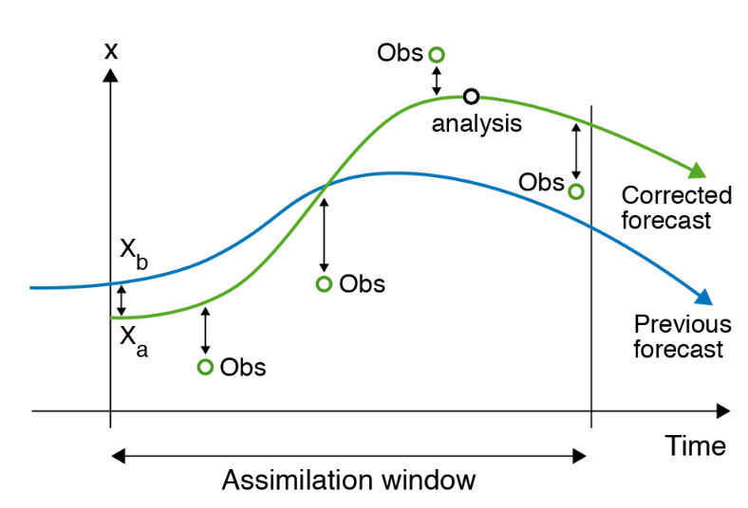
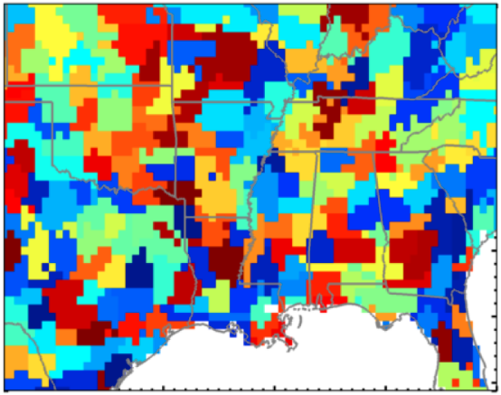
There are many other approaches to assimilation and emissions correction
Variational approaches iteratively approximate optimal solution…
The analytical inversion perturbs
clusters of grid cells to obtain full error characterization…
ECMWF
Sheng et. al., 2018
…but 4D-Var requires GEOS-Chem adjoint, which may not be ideal for some problems
…but requires hundreds of runs, and
works only for linear problems

Slide 11
CHEEREIO makes ensemble data assimilation as easy as running GEOS-Chem across many species/observers
Customization: Assimilate anything, in any GEOS-Chem configuration or simulation.
Maintainability: Science automatically aligned with latest model version
Powerful API: Minimal programming to implement any experiment
Easy deployment: One configuration file controls installation and settings
Speed: Runs slower, but not an order of magnitude slower, than GEOS-Chem classic

Slide 12
Assemble the building blocks of your simulation in the configuration file
Combine the observations you want to use…
OMI
TROPOMI
GEMS
Select concentrations in your state vector…
From one file…
Surface obs.
Customize!
NO
NO₂
HNO₃
ens_config.json
…and customize filters and aggregation.
…and how they are defined.
Surface
Column sum
Tropospheric column
Define emissions in your state vector…
…and specify uncertainties.
NO_{x}
Transport NO_{x}
CHEEREIO puts the pieces together!
NO
NO₂
Industrial NO_{x}
Group emissions into families
Separate sectors for source attribution

Slide 13
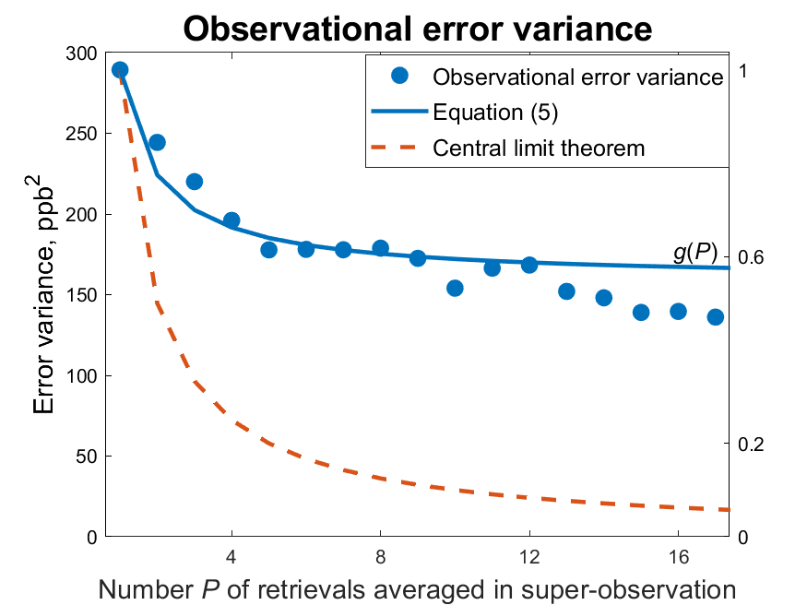
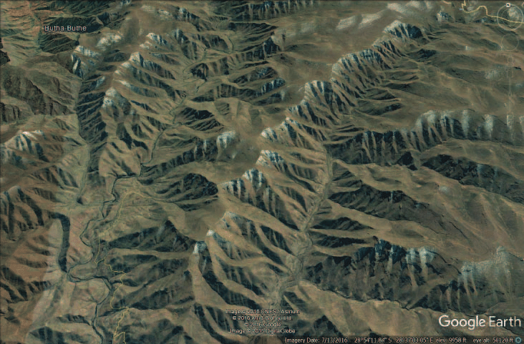
CHEEREIO supports many customizations: aggregating into super-observations
Chen et al., 2023
Same background ➔ correlated retrieval errors
$$σ_{super}^{2}=σ_{retrieval}^{2}\left(\frac{1−r_{retrieval}}{P}+r_{retrieval}\right)+σ_{transport}^{2}$$

Slide 14
Table of contents
Introduction to ensemble data assimilation and CHEEREIO
Installing CHEEREIO and building your first ensemble
Selecting or adding observation operators
Running and debugging CHEEREIO
Postprocessing and data analysis tools

Slide 15
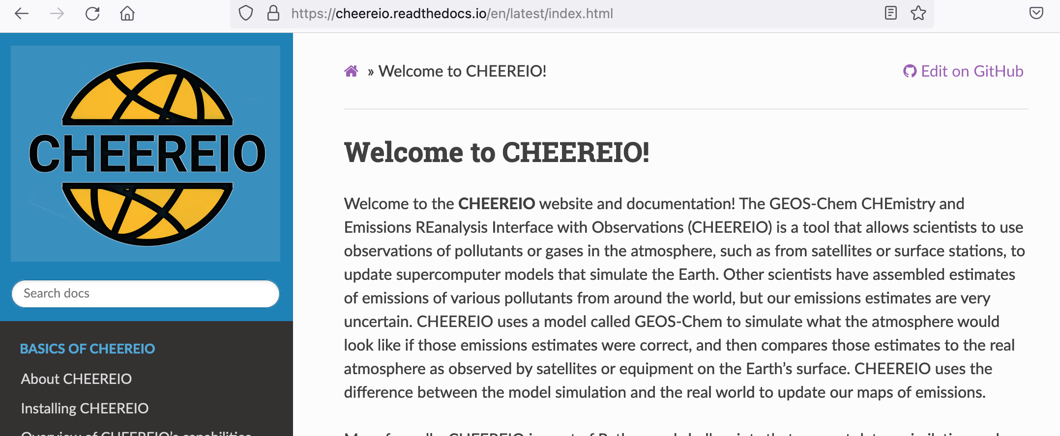
Getting ready: detailed documentation is provided on ReadTheDocs
All the material discussed today and much more is covered in the CHEEREIO documentation, available at bit.ly/CheereioDocs

Slide 16
Getting ready: frequently asked questions
How hard is it to run CHEEREIO?
If your system is set up to run GEOS-Chem Classic, it can run CHEEREIO with a few very minor modifications. User experience is also similar to running GC.
What input data is required for CHEEREIO?
Same as GEOS-Chem Classic, plus whatever observational data you would like to assimilate (e.g. satellite datasets).
What compute resources are required for CHEEREIO?
A cluster is necessary. CHEEREIO involves running an ensemble of ~16-64 GEOS-Chem runs. Because the calculation is embarrassingly parallel, these runs can be on different nodes or even different partitions (no MPI). Options are available to trade off cores/memory for speed.

Slide 17
Getting ready: using git to obtain source code
Clone the CHEEREIO repository from GitHub: git clone git@github.com:drewpendergrass/CHEEREIO.git
If you want a CHEEREIO version before the latest release, check out now: git checkout -b NewBranch tags/v1.3.1
Clone the GEOS-Chem Classic repository inside CHEEREIO, or copy GCClassic repo already downloaded.
git clone --recurse-submodules https://github.com/geoschem/GCClassic.git GCClassic
This folder must be named GCClassic.

Slide 18
A tour of the CHEEREIO top-level code directory

Slide 19
Getting ready: setting up software environments
Requirements: GEOS-Chem Classic 13/14 environment, plus
Python as managed by Anaconda or Mamba
jq
Ultra lightweight JSON library for shell. Most clusters have it installed as a module
Parallel
Standard lightweight shell-level parallelization library. Most clusters have it installed as a module

Slide 20
Getting ready: setting up software environments
Environment file
Conda environments
Modify environments > cheereio.env for your system
Install cheereio and animation conda environments (environments > cheereio.yaml and > animation.yml)
Command likely will look like the following:
conda env create -f cheereio.yaml
OR
mamba env create -f cheereio.yaml
Modify CondaEnv and AnimationEnv fields in ens_config.json to match installed environment names (cheereio and animation by default).

Slide 21
Initialization: defining ensemble settings
Ens_config.json supersedes the normal GEOS-Chem run directory creation process.
At the top of the file, you specify your GEOS-Chem settings

Slide 22
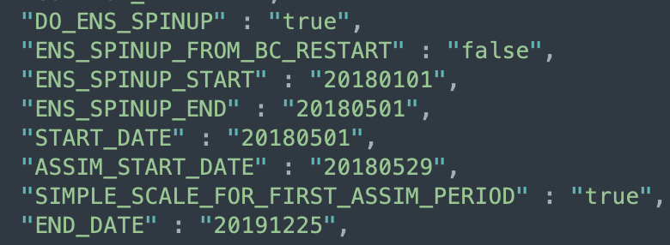
Initialization: defining ensemble settings
Beyond normal spinup, LETKF requires ensemble spinup — time for emissions differences between ensemble members to be realized in concentration spreads.
First observations
Ensemble spinup
Concentration
(Optional) Scale initial ensemble mean to match observation mean
Ensemble of simulations, all starting from same restart
LETKF begins

Slide 23
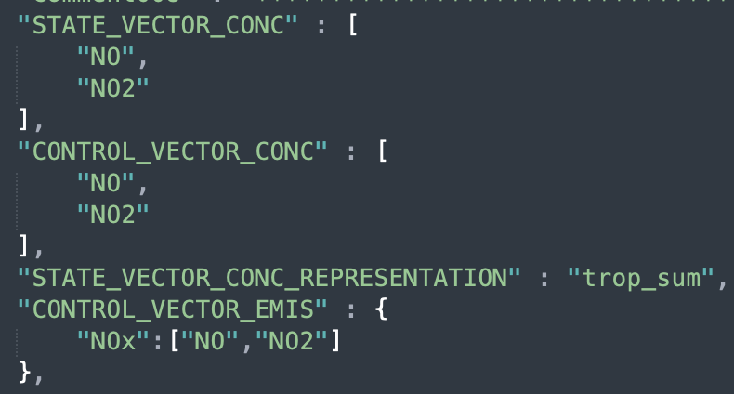
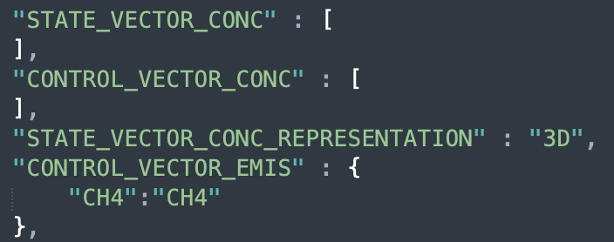
Initialization: defining ensemble settings
Define state vectors

Slide 24
Initialization: deploying the ensemble
Activate cheereio shell environment
In setup_ensemble.sh turn on Template Run directory creation only
Execute script, then navigate to MY_PATH/RUN_NAME
Copy of code used to run ensemble
Ensemble GC run directories
Postprocessed output files
Temporary files, runtime status
Template GC run directory

Slide 25
Initialization: deploying the ensemble
Edit template run directory. Settings will be repeated across the ensemble.
CHEEREIO automatically edits HEMCO_Config to link emissions to LETKF scale factors

Slide 26
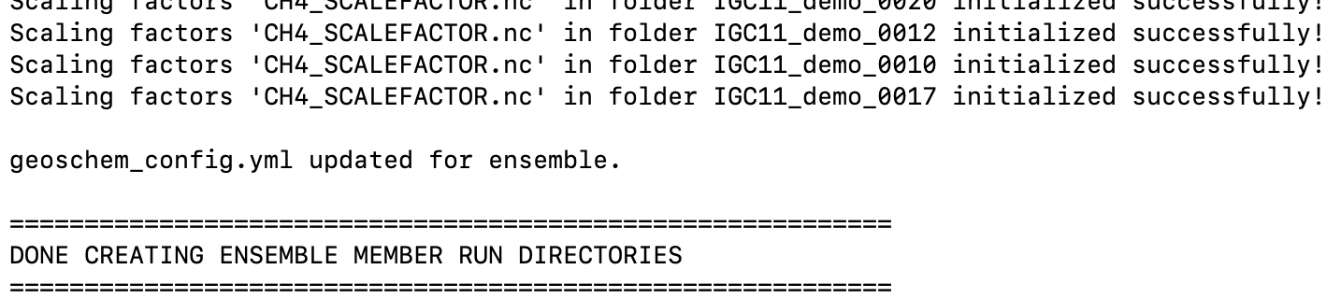
Initialization: deploying the ensemble
Return to setup_ensemble.sh
In setup_ensemble.sh turn off Template Run directory creation and turn on compilation and setup ensemble runs.
Execute. We are now ready to run the ensemble!

Slide 27
Table of contents
Introduction to ensemble data assimilation and CHEEREIO
Installing CHEEREIO and building your first ensemble
Selecting or adding observation operators
Running and debugging CHEEREIO
Postprocessing and data analysis tools

Slide 28
Add new observation operators easily with Python-based inheritance
CHEEREIO is assembled from interchangeable blocks
CHEEREIO provides a template for observation operators…
Observation operators go here

Slide 29
Add new observation operators easily with Python-based inheritance
CHEEREIO is assembled from interchangeable blocks
CHEEREIO provides a template for observation operators…
OMI
TROPOMI
GEMS
Surface
Add your own!
…that then automatically plug in to the CHEEREIO workflow
GEMS inversion ready to go!

Slide 30
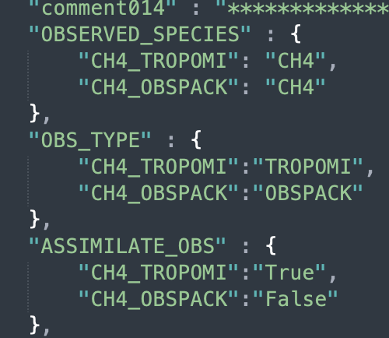
Automatically validate results with other observers within one workflow
Within the configuration file…
…turn on two observers of one species (CH₄)…
…turn on TROPOMI for LETKF updates
TROPOMI
Surface
…but use ObsPack as an independent validation set (no assimilation)
Notes:
What’s great about this is that any CHEEREIO observation operator can automatically be used to validate a run, no programming required.

Slide 31
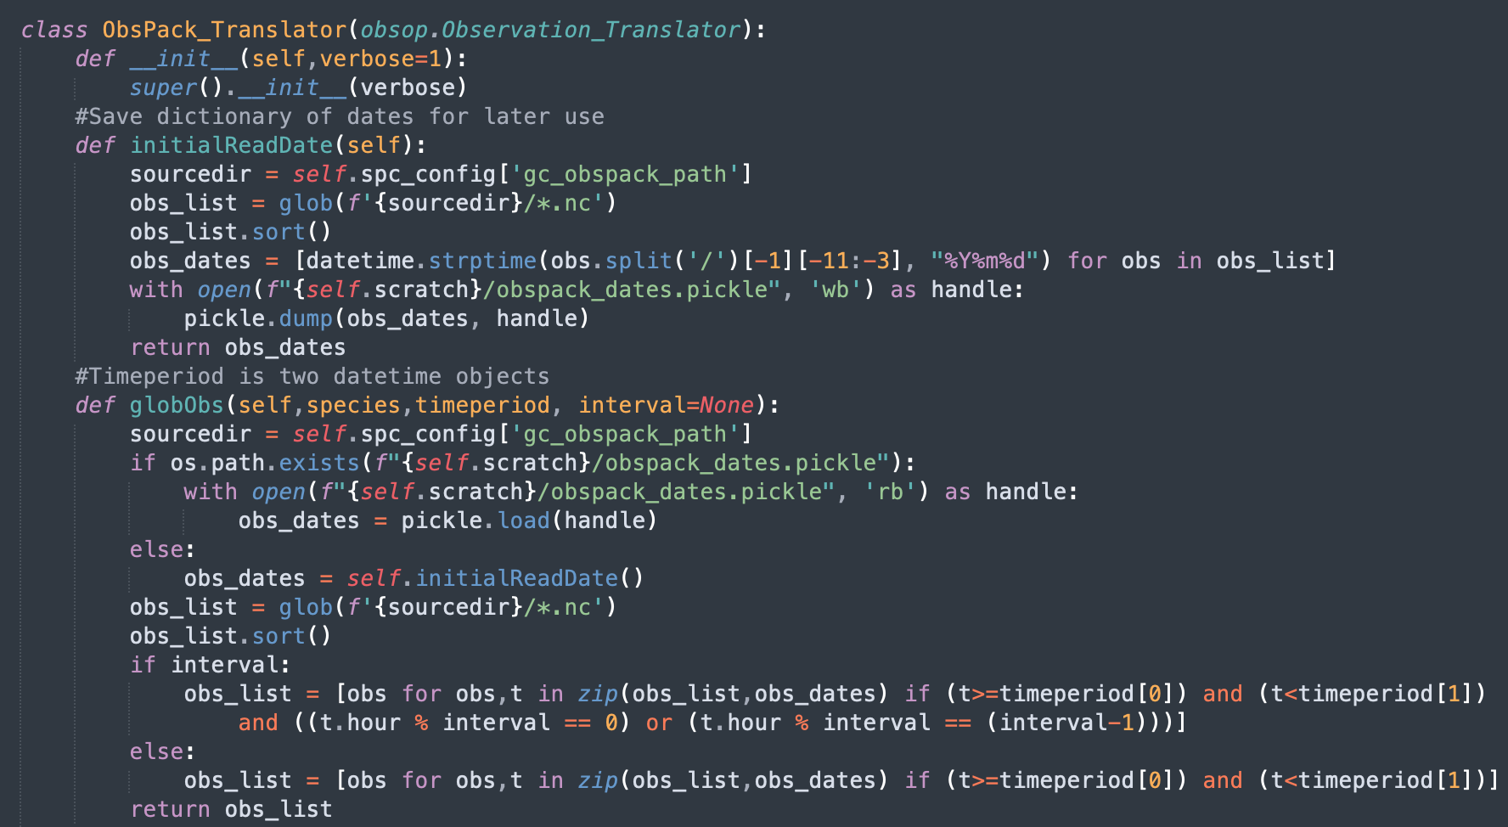
Anatomy of a CHEEREIO observation operator
A Python class which inherits the CHEEREIO Observation Translator parent class — templating
(Optional) Utility method that links observer dates to files — speeds up CHEEREIO
(Optional) Obspack-specific method which finds files with observations between two dates

Slide 32
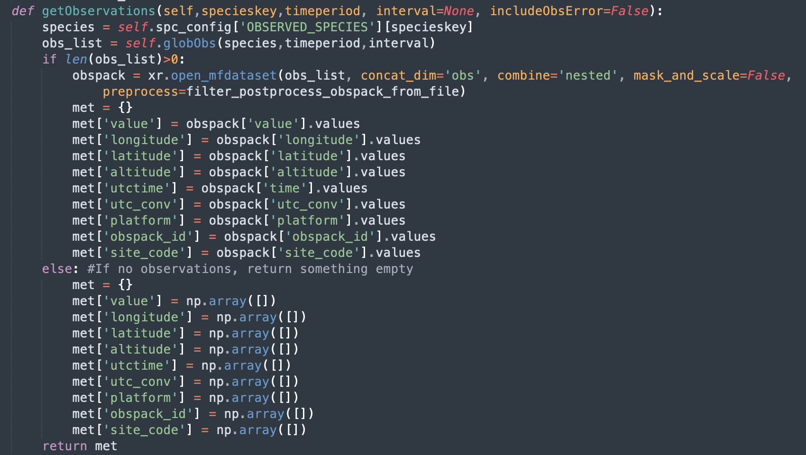
Anatomy of a CHEEREIO observation operator
Function which loads observation data and saves to a standardized dictionary.
Requires species key (references observed species in ens_config) and time period.
MANDATORY FUNCTION 1
CHEEREIO requires 1D arrays for observer value, longitude, latitude, and utctime. All other fields are optional.

Slide 33
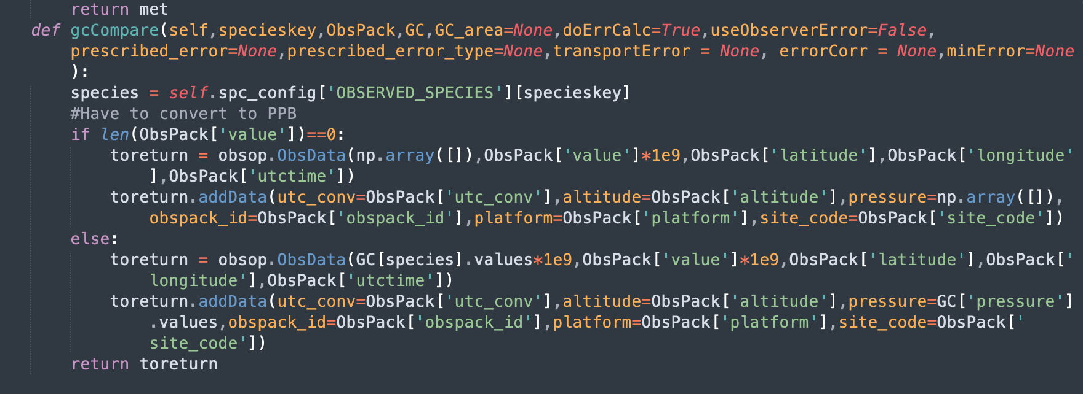
Anatomy of a CHEEREIO observation operator
Core observation operator which compares GEOS-Chem and observations.
MANDATORY FUNCTION 2
Data is returned in ObsData class, which is a list of 1D arrays where GEOS-Chem data are aligned

Slide 34
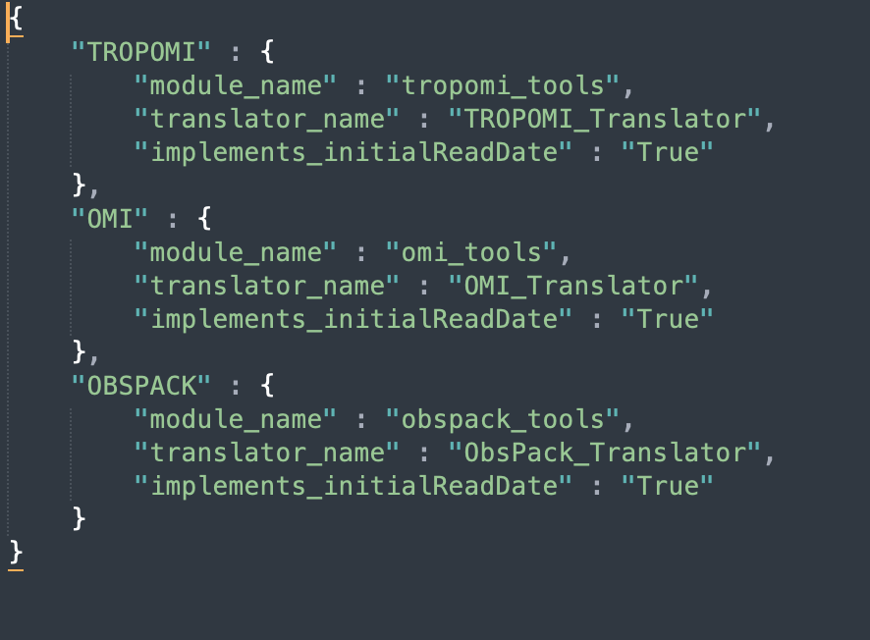
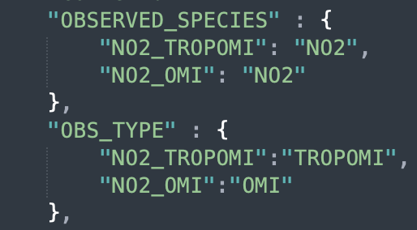
Anatomy of a CHEEREIO observation operator
operators.json
CHEEREIO knows to look for your observation operator because of the operators.json file in top-level directory
Looks inside core/tropomi_tools.py
ens_config.json
Finds the TROPOMI_Translator class

Slide 35
Table of contents
Introduction to ensemble data assimilation and CHEEREIO
Installing CHEEREIO and building your first ensemble
Selecting or adding observation operators
Running and debugging CHEEREIO
Postprocessing and data analysis tools

Slide 36
Run time: executing the ensemble
(1) Execute nohup bash run_ensspin.sh &
(2) Once all runs complete, execute nohup bash run_ens.sh &

Slide 37
CHEEREIO runtime: behind the scenes

Slide 38
Run time: checking ensemble progress, duplication, and backup restoration

Slide 39
Table of contents
Introduction to ensemble data assimilation and CHEEREIO
Installing CHEEREIO and building your first ensemble
Selecting or adding observation operators
Running and debugging CHEEREIO
Postprocessing and data analysis tools

Slide 40
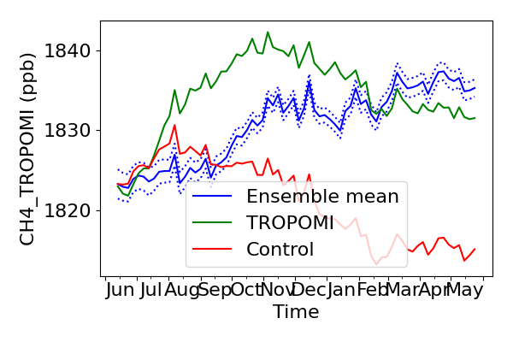
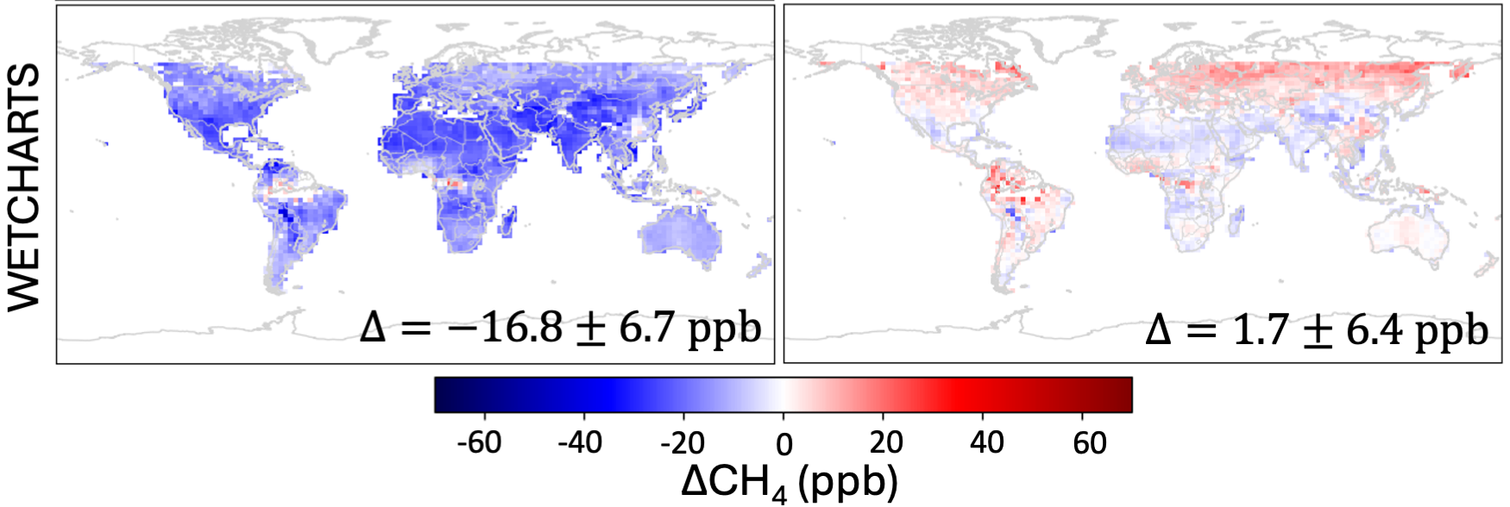
Postprocessing: ensemble snapshots and full postprocessing suite
While CHEEREIO is running
Get super-fast view of ensemble status with snapshot.sh

Slide 41
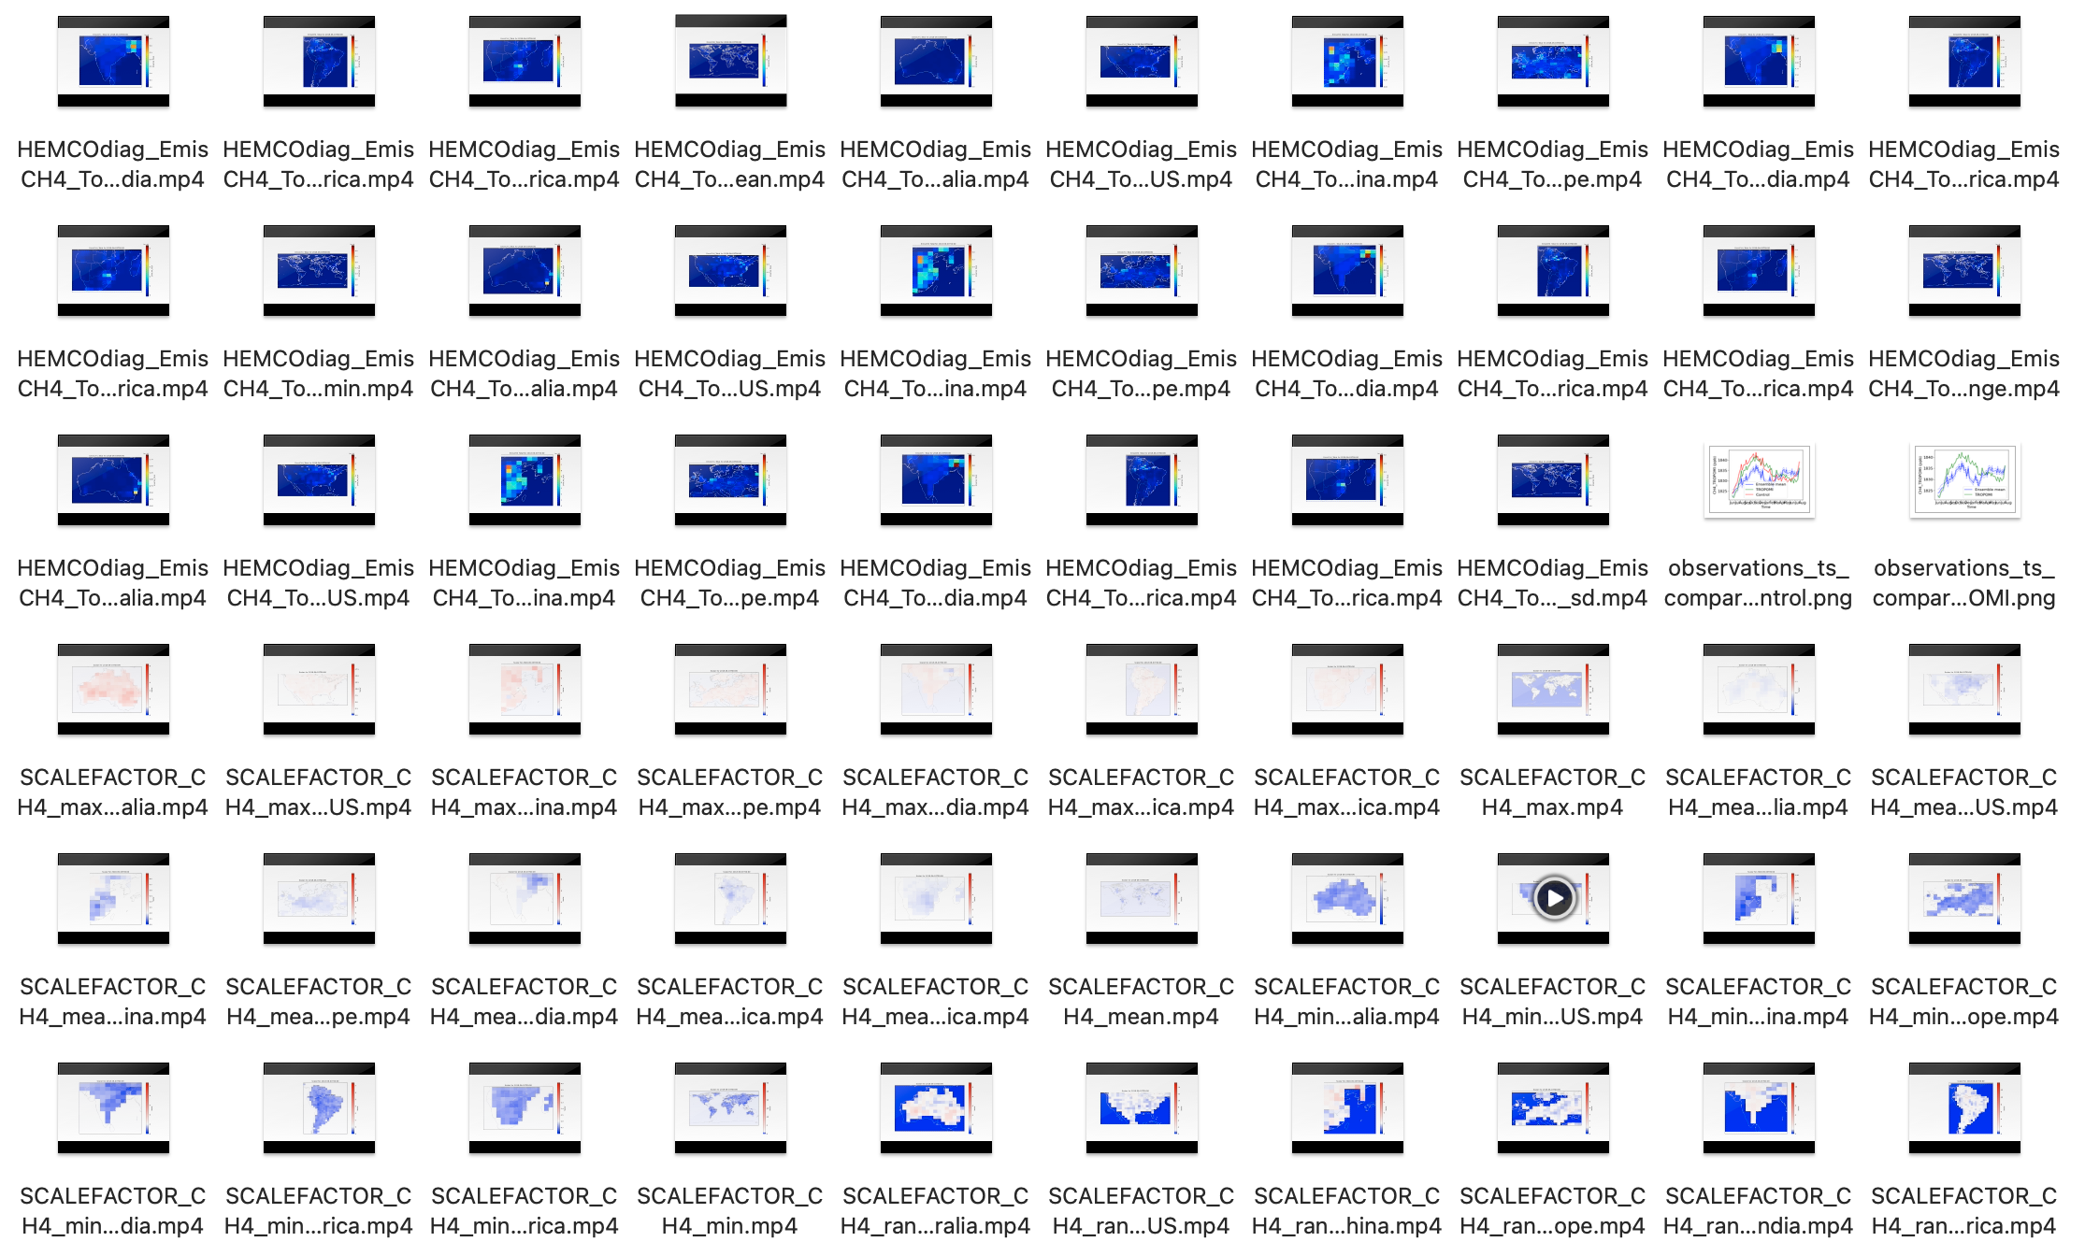
Postprocessing: ensemble snapshots and full postprocessing suite
After CHEEREIO completes
Get complete set of postprocessing files with postprocess.batch
Total posterior methane emissions
January through May 2019

Slide 42
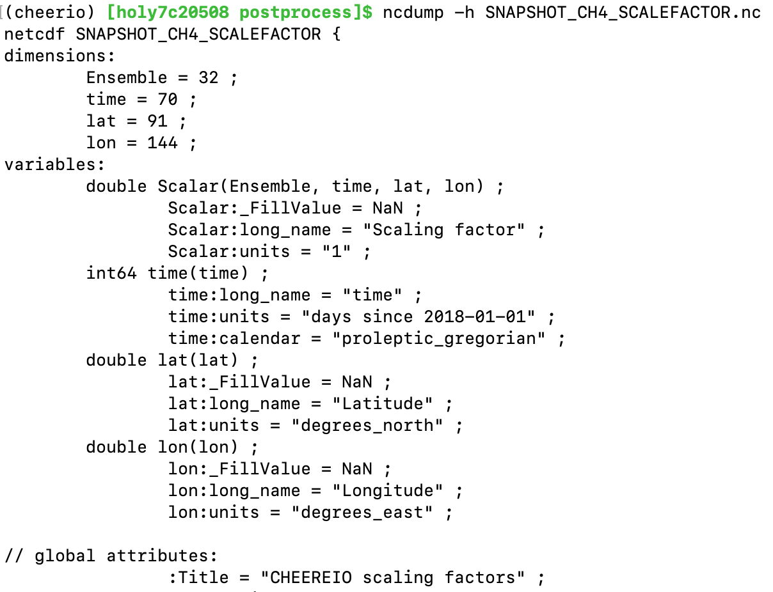
Postprocessing: emissions scaling factors
Hemco output (full emissions, scale factors applied) follows same conventions

Slide 43
Postprocessing: bigY, or observation operator raw output
Entries for every assimilation period

Slide 44
Postprocessing: bigY, or observation operator raw output
For every date, a table of each ensemble mapped to observations, along with geospatial data and metadata

Slide 45
Postprocessing: bigY, or observation operator raw output
For every date, a table of each ensemble mapped to observations, along with geospatial data and metadata
…

Slide 46
Postprocessing: bigY gridded for plotting
…
GC ensemble mean, mapped to operator, gridded (time,lat,lon)
Observations, averaged to GC grid (time,lat,lon)
Control GC simulation, no assimilation (time,lat,lon)

Slide 47
Useful resources
CHEEREIO paper: https://gmd.copernicus.org/articles/16/4793/2023/
CHEEREIO website: https://cheereio.seas.harvard.edu
CHEEREIO documentation: https://cheereio.readthedocs.io
GEOS-Chem website: https://geoschem.github.io/
Details on GEOS-Chem (and CHEEREIO) software requirements: https://geos-chem.readthedocs.io/en/stable/getting-started/system-req-soft.html
I am here to help! Ask any questions at https://github.com/drewpendergrass/CHEEREIO/issues (preferred) or by email: pendergrass@g.harvard.edu

