Slide 1
Interpreting fine particulate matter (PM_{2.5}) trends in South Korea, 2011-2022 Drew Pendergrass | AMS Annual Meeting January 14, 2025 with Daniel J. Jacob, Yujin J. Oak, Ruijun Dang, Laura Hyesung Yang, Ellie Beaudry, Nadia K. Colombi, Shixian Zhai, Hwajin Kim, Jin-soo Choi, Jin-soo Park, Soontae Kim, and Hong Liao

Slide 2
Table of contents
Producing a unified national PM_{2.5} dataset for South Korea
Three distinct periods of PM_{2.5} behavior:
Transition 2: Changes in particulate nitrate
Transition 1: Evidence from the weekend effect
Conclusions
2011-2014
2015-2018
2019-2022
Transition 1
Transition 2

Slide 3
Table of contents
Producing a unified national PM_{2.5} dataset for South Korea
Three distinct periods of PM_{2.5} behavior:
Transition 2: Changes in particulate nitrate
Transition 1: Evidence from the weekend effect
Conclusions
2011-2014
2015-2018
2019-2022
Transition 1
Transition 2

Slide 4
PM_{2.5} surface stations were deployed across South Korea in 2015, missing key events
2013 obs.
2016 obs.
2019 obs.
2022 obs.
40
30
Seoul had its own network before 2015
Annual PM_{2.5} (µg m⁻³)
20
10
2012 2013 2014 2015 2016 2017 2018 2019 2020 2021 2022
China: Action Plan on Prevention and Control of Air Pollution
Korea: Comprehensive Action Plan on Fine Dust
Seoul: seasonal fine dust management program (Dec.-Mar.)
Region: Covid lockdowns
100
80
60
50
40
30
PM_{2.5} (µg m⁻³)
20
10
8
6
5
4
Notes:
No before and after for Korea or China with 2013 action plan – most impactful policy. Can’t compare to impacts of 2017 policy.

Slide 5
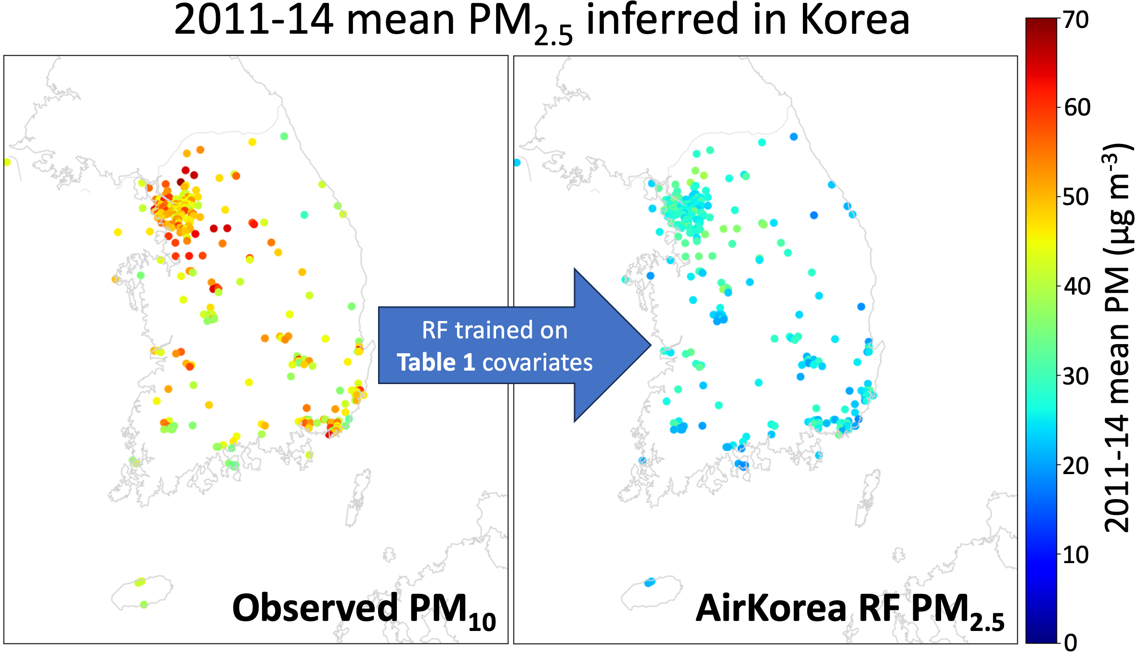
However, AirKorea network measured PM₁₀, O₃, NO₂, CO, and SO₂ before 2015
Infer with random forest
Observed PM₁₀

Slide 6
PM₁₀ by far most important predictor for PM_{2.5} at AirKorea sites, followed by CO and humidity
RF Shapley analysis (less impt. variables not shown)

Slide 7
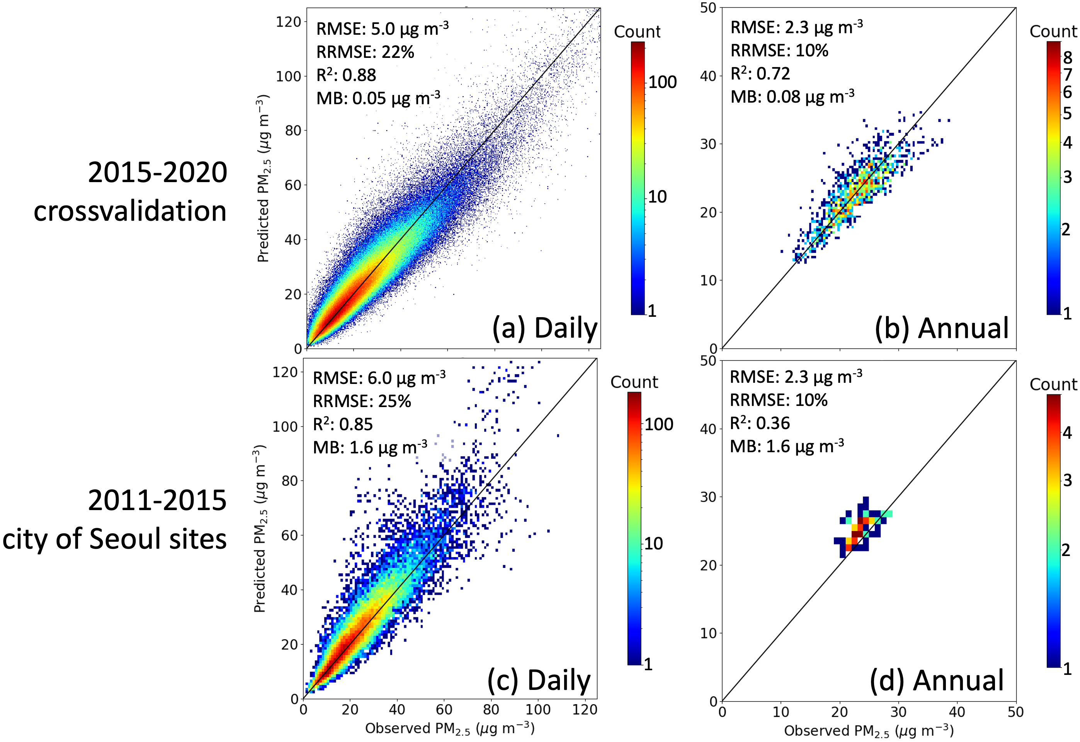
AirKorea RF PM_{2.5} performs well in 2015-20 training period and has only modest bias against separate 2011-15 Seoul municipal PM_{2.5} dataset
Pure extrapolation! We do not use Seoul PM_{2.5} data for training.

Slide 8
Table of contents
Producing a unified national PM_{2.5} dataset for South Korea
Three distinct periods of PM_{2.5} behavior:
Transition 2: Changes in particulate nitrate
Transition 1: Evidence from the weekend effect
Conclusions
2011-2014
2015-2018
2019-2022
Transition 1
Transition 2

Slide 9
We find PM_{2.5} decreases everywhere, after controlling for meteorology using multi-linear regression
Met-normalized
PM_{2.5} trend
MLR R²
2011-22
2011-22
-6
-4
-2
0
2
4
6
0.25
0.30
0.35
0.40
0.45
∆PM_{2.5} (µg m⁻³ a⁻¹)
R²
Notes:
Aggregate sites to 0.25 grid and detrend
Use MLR to fit PM2.5 to top three met variables (by AIC) to make met model
Variables considered are: boundary layer height, sea level pressure, precip, surface RH, surface T, 10m wind speed, meridional (v) winds at 850 hPa
Remove met fit; residuals plotted.

Slide 10
Overall decrease obscures three distinct periods of PM_{2.5} behavior

Slide 11
Table of contents
Producing a unified national PM_{2.5} dataset for South Korea
Three distinct periods of PM_{2.5} behavior:
Transition 2: Changes in particulate nitrate
Transition 1: Evidence from the weekend effect
Conclusions
2011-2014
2015-2018
2019-2022
Transition 1
Transition 2

Slide 12
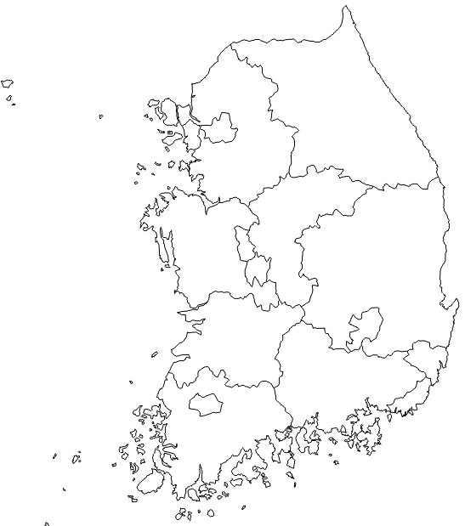
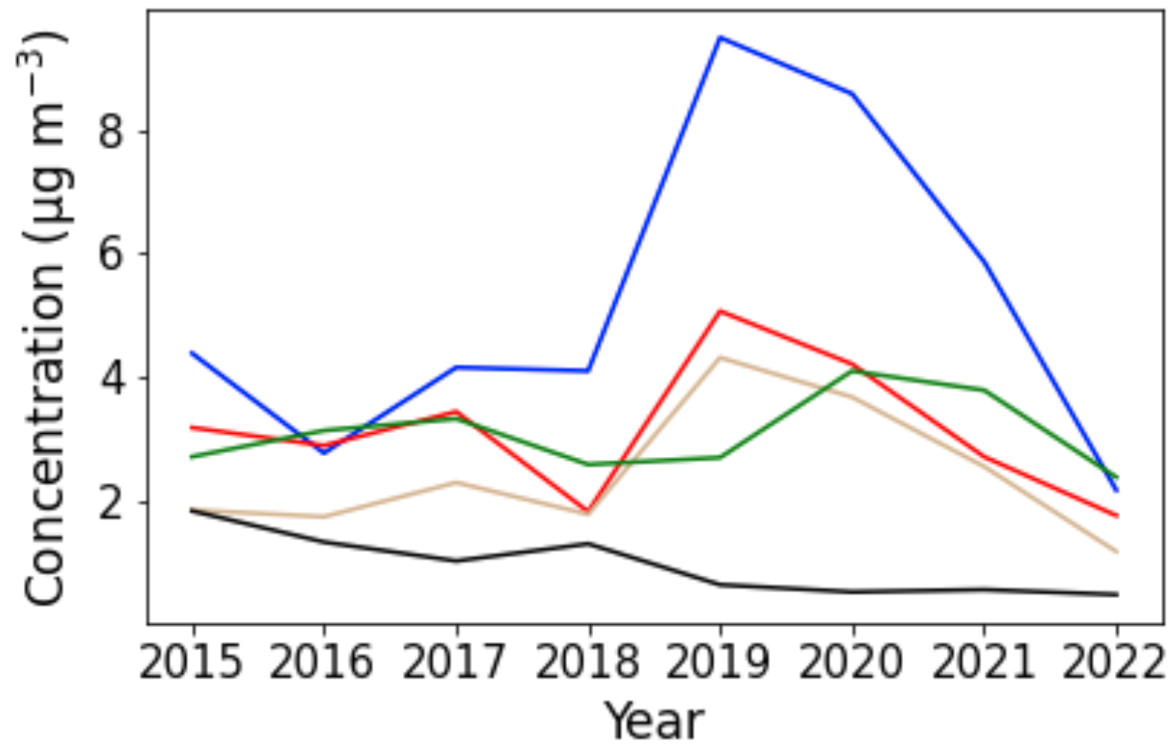
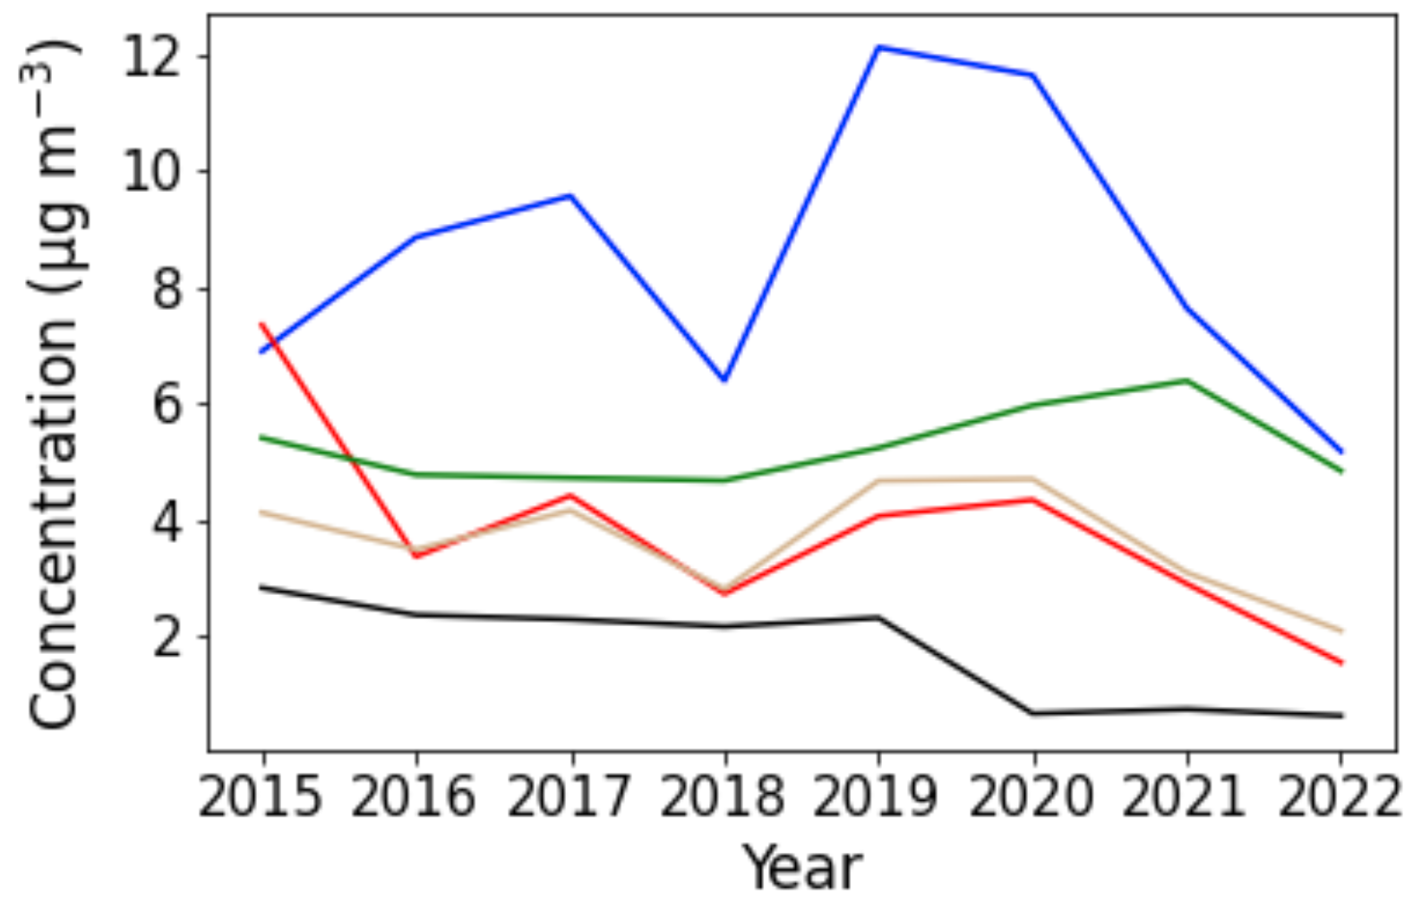
Particulate nitrate (pNO₃⁻) drives DJF increases for 2015–2019 and decreases for 2019–2022
Baeng.
Seoul
Baengnyeong
obs.
DJF
Seoul obs.
DJF
2
3
2
3

Slide 13
pNO₃⁻ in Korea can be limited by NO or NH₃ emissions depending on ambient conditions
Thermodynamic partitioning
Oxidation
hv
HNO₃
PM_{2.5} nitrate
NO
NO₂
NH₃
T RH
NH₄⁺ + NO₃⁻
O₃, peroxy
OH
H₂SO₄
SO₂
2NH₄⁺ + SO₄²⁻
NH₃
PM_{2.5} sulfate
Fuels, soil
Coal
agriculture, vehicles
Slide adapted from Ruijun Dang
Notes:
SO2 down, so in transitional phase more NH3 available to form particulate nitrate and more mass in particle phase.

Slide 14
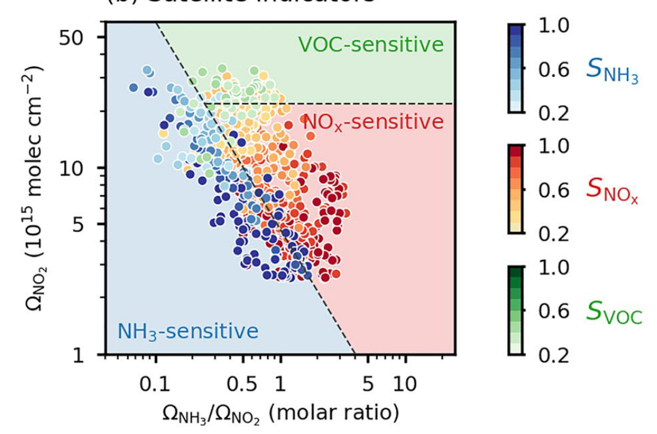
Like ozone, pNO₃⁻ sensitivity to emissions can be diagnosed from space
Dang et al., 2023
Notes:
Say that VOC sensitive regime is not relevant in South Korea at the spatial resolution we consider. Comes up in the North China Plain.

Slide 15
NH₃/NO₂ ratio suggests pNO₃⁻ has become NO_{x} limited from 2019 in Seoul Metropolitan Area (SMA)
Notes:
NH3 has stayed relatively constant, NOx decreasing throughout the study period.

Slide 16
Table of contents
Producing a unified national PM_{2.5} dataset for South Korea
Three distinct periods of PM_{2.5} behavior:
Transition 2: Changes in particulate nitrate
Transition 1: Evidence from the weekend effect
Conclusions
2011-2014
2015-2018
2019-2022
Transition 1
Transition 2

Slide 17
There is a prominent PM2.5 “weekend effect” and it reverses sign around 2015
Daily gap-free 2×2 km² PM_{2.5} for all East Asia (used for these plots), available here:
Real PM_{2.5} observations from Seoul network

Slide 18
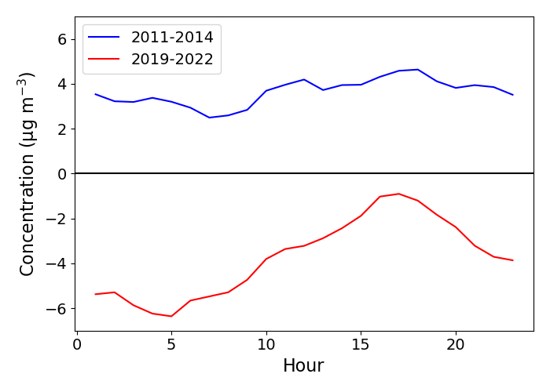
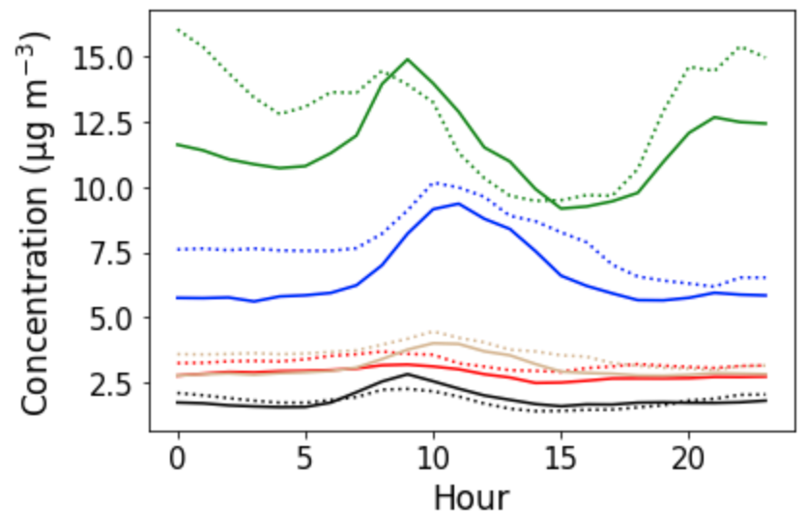
Secondary nighttime chemistry drives the weekend effect change
Seoul PM_{2.5} weekday minus weekend
by hour of day (city-wide observations)
Weekday
Weekend
Org
NO₃⁻
SO₄²⁻
NH₄⁺
BC
More polluted during week
∆PM_{2.5} (µg m⁻³)
Less polluted during week
Hour of day
Jan. 2016-18 PM₁ composition
Data from Hwajin Kim
Notes:
Before 2015, steady weekend effect throughout day
After 2015, weekend effect driven by nighttime dynamics.
Also note that ozone has increased at all times of day over the study period.

Slide 19
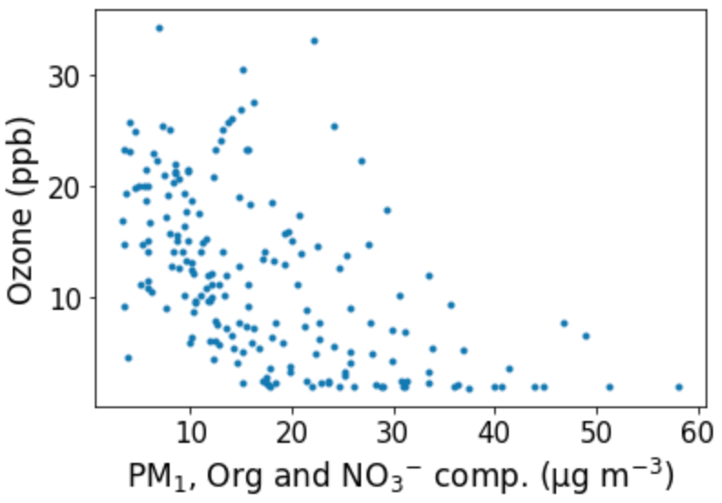
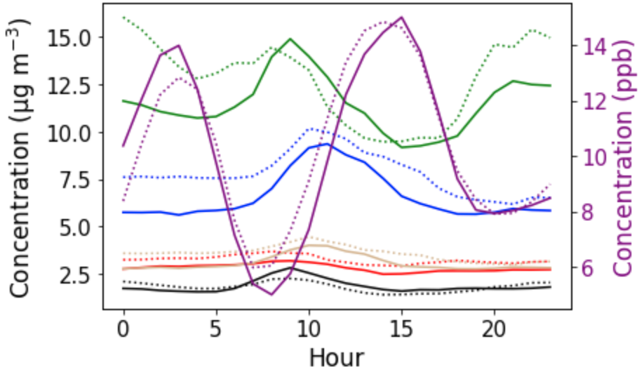
Secondary nighttime chemistry drives the weekend effect change
Weekday
Weekend
Org
NO₃⁻
SO₄²⁻
NH₄⁺
BC
O₃
Nighttime O₃ titration

Slide 20
Conclusions
PM_{2.5} decreases in South Korea from 2011 through 2022, but DJF concentrations increase in the 2015-19 interval.
DJF PM_{2.5} increased in 2015-19 because of increased nitrate as sulfate declined and ozone increased, then declined as pNO₃⁻ production became NO_{x}-limited and responded to emissions cuts.
Since 2015 weekends are more polluted than weekdays in South Korea, reflecting an increasing role for oxidants (secondary PM_{2.5}) as opposed to primary sources.
Nighttime reaction pathways play an important role in the weekend effect and may increase in importance as ozone continues to rise.

