Slide 1




Running CHEEREIO 1.4.1
A hands-on guide to nonlinear ensemble data assimilation and emissions estimation with GEOS-Chem
12th International GEOS-Chem meeting clinic
Drew Pendergrass
June 8, 2026

Slide 2
Table of contents
Introduction to ensemble data assimilation and CHEEREIO
Installing CHEEREIO and building your first ensemble
Selecting or adding observation operators
Running and debugging CHEEREIO
Postprocessing and data analysis tools

Slide 3
Table of contents
Introduction to ensemble data assimilation and CHEEREIO
Installing CHEEREIO and building your first ensemble
Selecting or adding observation operators
Running and debugging CHEEREIO
Postprocessing and data analysis tools

Slide 4
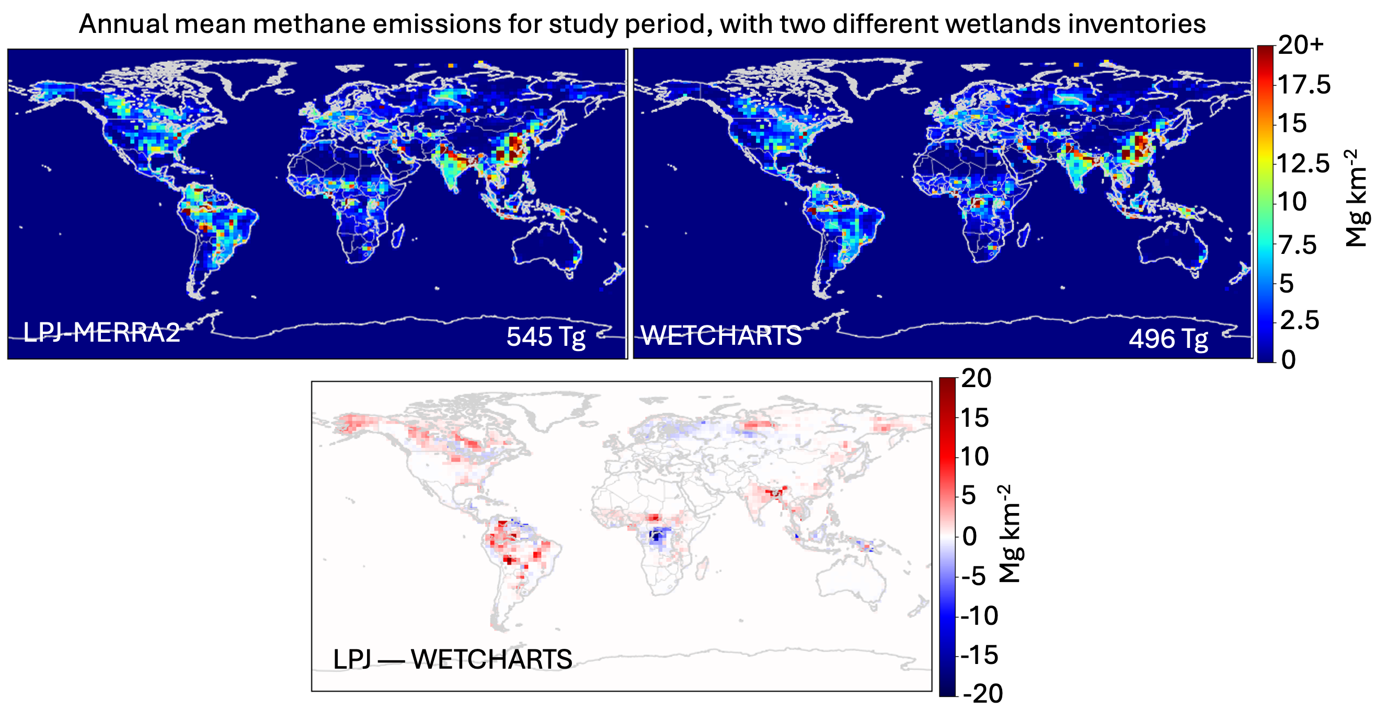
Satellite data can monitor rapidly-changing emissions
Simulated atmosphere
Virtual
observations
Real satellite observations
Real world
“What if our emissions estimates were correct?”
Bottom-up emissions estimate
Pendergrass et al., 2023

Slide 5
Satellite data can monitor rapidly-changing emissions
Simulated atmosphere
Data-driven emissions
Real satellite observations
Prior emissions estimate
Pendergrass et al., 2023

Slide 6
The bottom-up method of emissions estimation
Emissions factor
x
Activity level
=
Emissions
x
=
Emissions from electricity
Amount of electricity generated
Fuel type, scrubbers, etc.
+
=
Emissions from transportation
x
Vehicle type
+
Distance traveled
Emissions from other sectors
=
Total emissions
Bottom-up emissions are necessary but imperfect.
Observations can help quantify missing sources.
Notes:
Repeat for every pollutant and every source of each pollutant.

Slide 7
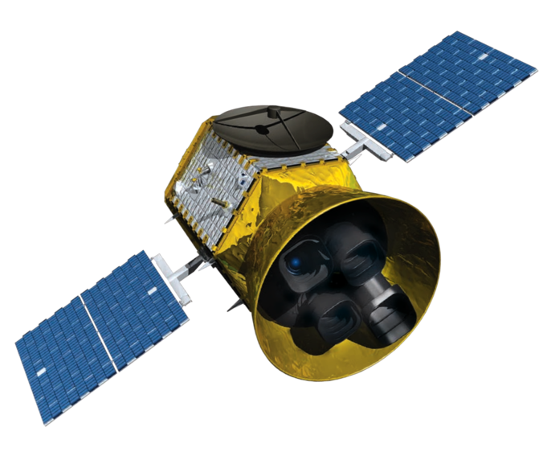
LETKF randomizes emissions and compares model predictions to observations
Real satellite measures
1985 ppb NO_{x}…
If we emit 500 kg CH₄ per hour…
… satellite would measure
1980 ppb CH₄
If we emit 1000 kg CH₄ per hour…
… so truth is in between these two guesses
… satellite would measure 1990 ppb CH₄

Slide 8
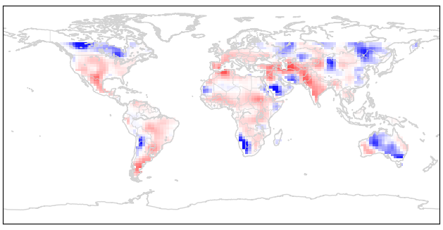
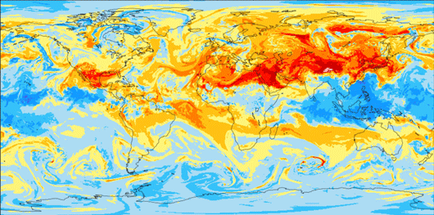
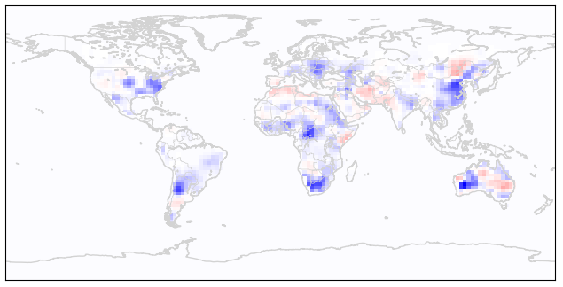

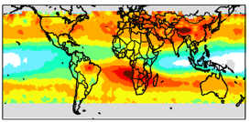
How LETKF can estimate emissions of any species
…
…
Run an atmospheric model for each
emission field
Generate n perturbations
to initial emissions map
Generate n simulated 3D atmospheres, each reflecting different emissions
Apply observation operators (e.g. satellite averaging kernels)
…
Compare simulated observations to actual observations
…
Use ensemble spread to approximate prior error covariance matrix
Specify or calculate observational error covariance matrix
https://cheere.io
Pendergrass et al., 2023

Slide 9
How LETKF can estimate emissions of any species
…
…
Run an atmospheric model for each
emission field
Weighting by covariance matrices, calculate optimal posterior emissions and/or concentrations
Generate n simulated 3D atmospheres, each reflecting different emissions
Repeat
Apply observation operators (e.g. satellite averaging kernels)
…
Compare simulated observations to actual observations
…
Use ensemble spread to approximate prior error covariance matrix
Specify or calculate observational error covariance matrix
https://cheere.io
Pendergrass et al., 2023

Slide 10
CHEEREIO automates LETKF inversions with state-of-the-science modeling and community tools
From one file…
ens_config.json
Specify observations on disk
Define emissions to optimize
Community library
NO_{x}
TROPOMI:
CO, NO₂, CH₄
NO
NO₂
Operator maps data to GEOS-Chem
IASI:
NH₃
CrIS:
Isop.
Group emissions
Specify uncertainties
Any surface data
Pick your model version and inputs
Or add with Python
Apply filters and real-time corrections
Standard inputs
Simulate
Observe

Slide 11
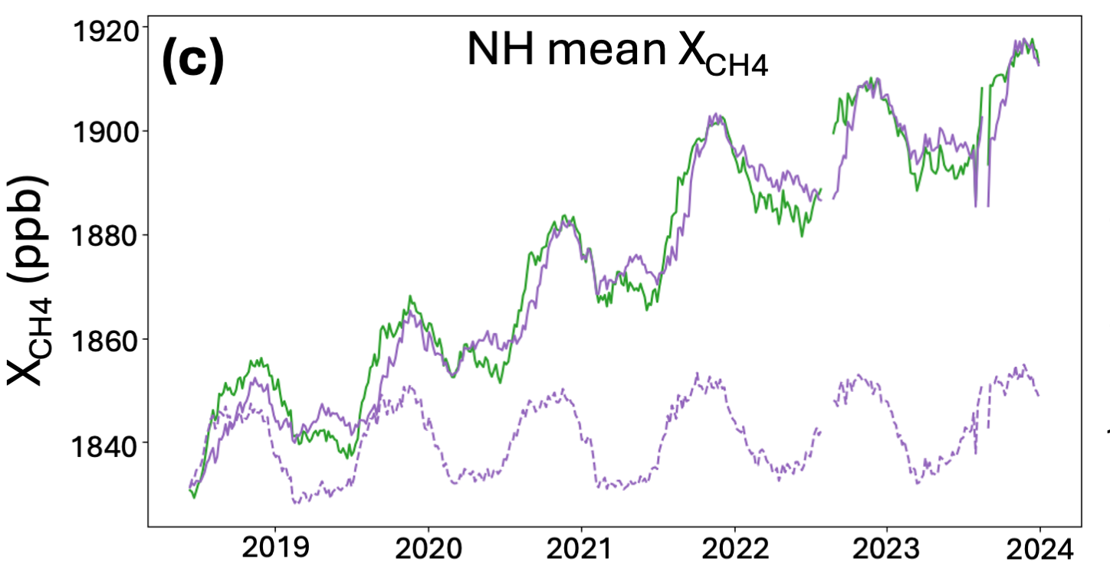
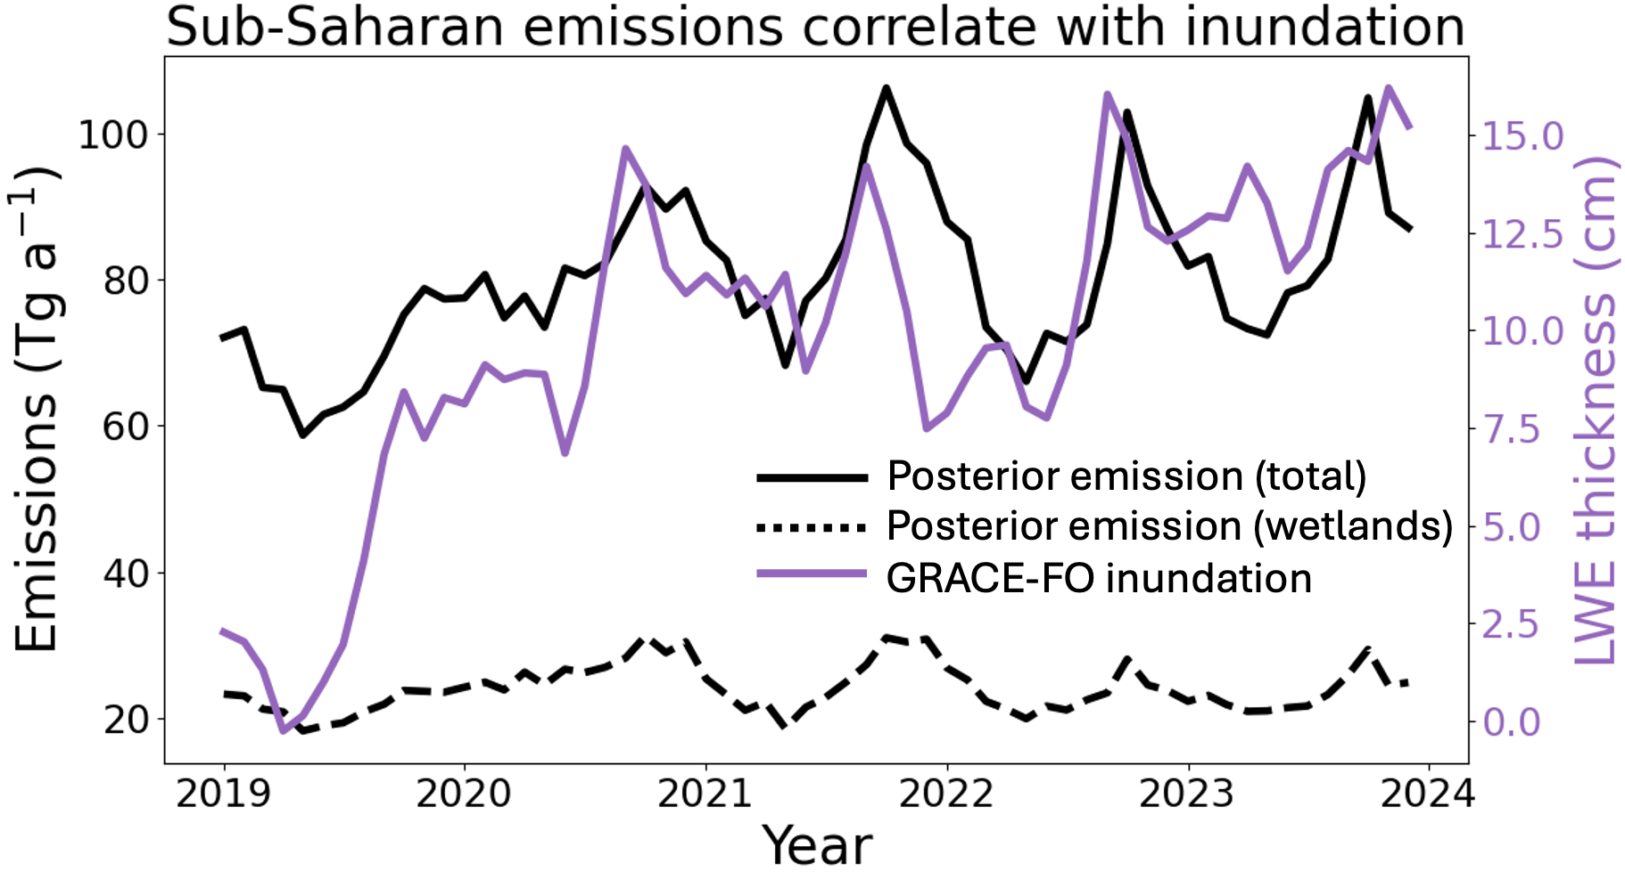
Past CHEEREIO results: global methane budget
Northern hemisphere mean methane columns
TROPOMI
Simulate
Observe
Posterior
Prior
Optimize
Emissions resolved in time…
Uncertainty
Pendergrass et al., 2025
…and space
NH₃ columns, July 2019

Slide 12
Past CHEEREIO results: understanding sectoral drivers of emissions change
In China, livestock drove the 2019-24 methane emissions increase, more than offsetting coal policy gains
Li et al., in review at ACP

Slide 13
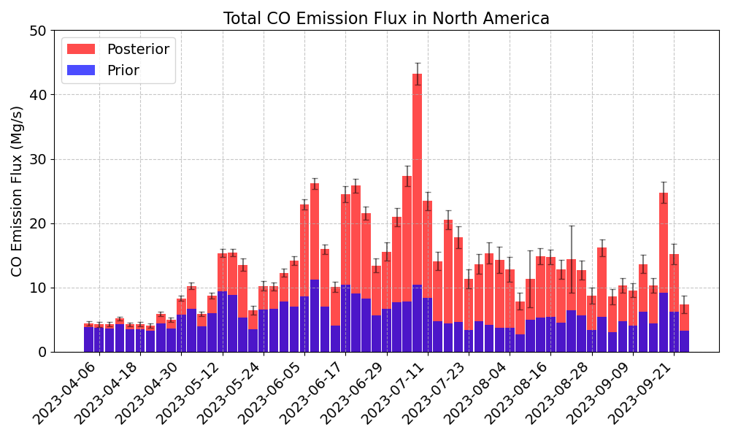
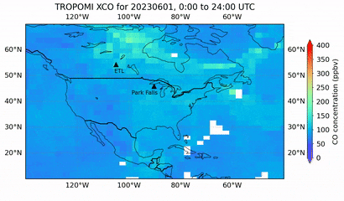
Past CHEEREIO results: near-real-time monitoring of Canadian wildfires with CO
Voshtani et al., 2025

Slide 14
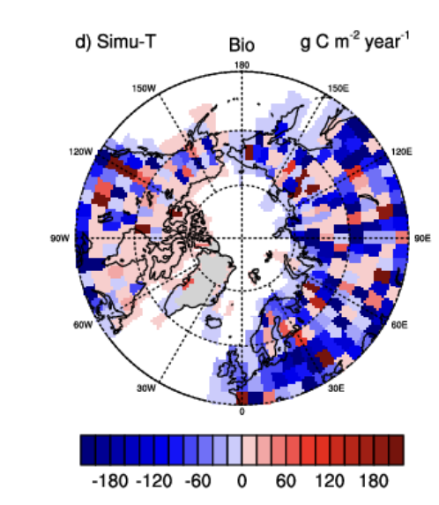
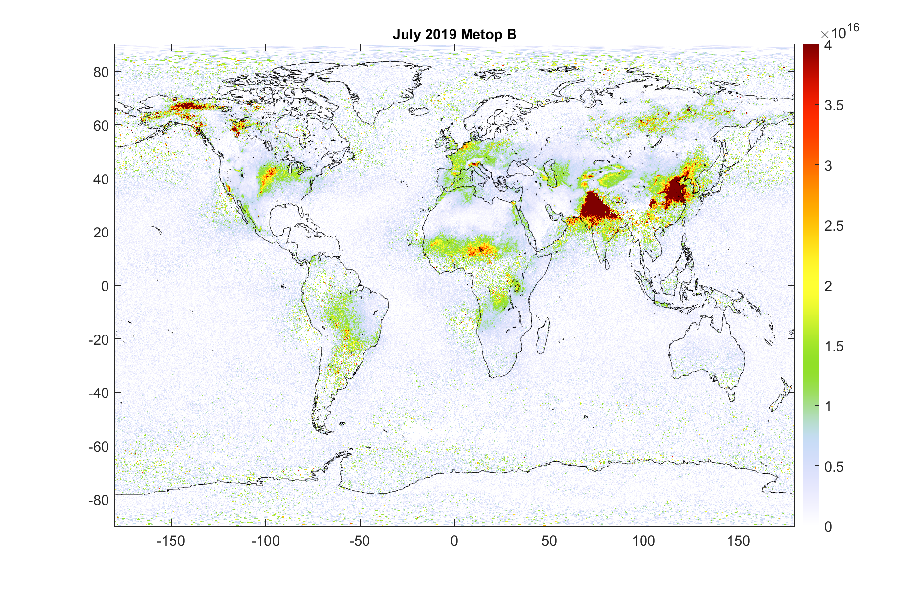
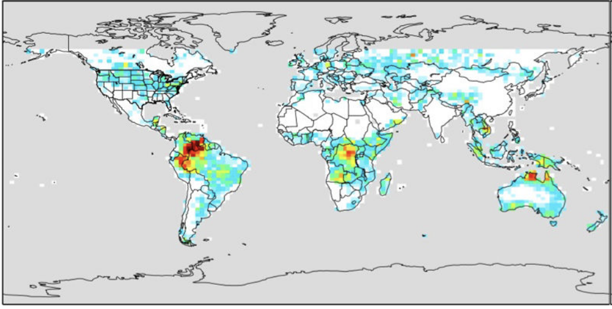
Exciting CHEEREIO work in progress
Inverting NH₃ (IASI) and NO_{x}/SO₂ (TROPOMI) (Drew Pendergrass, Duke)
Inverting CrIS VOC products, starting with isoprene and ethane (Dylan Millet and Kelley Wells, UMN)
Inverting CO₂ fluxes (Yiming Xu and Qianlai Zhuang, Purdue)

Slide 15
Table of contents
Introduction to ensemble data assimilation and CHEEREIO
Installing CHEEREIO and building your first ensemble
Selecting or adding observation operators
Running and debugging CHEEREIO
Postprocessing and data analysis tools

Slide 16
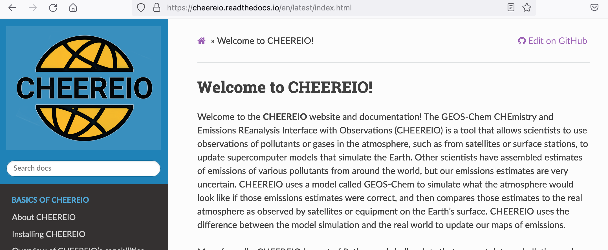

Getting ready: detailed documentation is provided on ReadTheDocs
All the material discussed today and much more is covered in the CHEEREIO documentation, available at bit.ly/CheereioDocs

Slide 17
Getting ready: frequently asked questions
How hard is it to run CHEEREIO?
  If your system is set up to run GEOS-Chem Classic, it can run CHEEREIO with a few very minor modifications. User experience is also similar to running GC.
What input data is required for CHEEREIO?
  Same as GEOS-Chem Classic, plus whatever observational data you would like to assimilate (e.g. satellite datasets).
What compute resources are required for CHEEREIO?
  A cluster is necessary. CHEEREIO involves running an ensemble of ~16-48 GEOS-Chem runs simultaneously. Because the calculation is embarrassingly parallel, these runs can be on different nodes or even different partitions (no MPI). Options are available to trade off cores/memory for speed.

Slide 18
Getting ready: using git to obtain source code
Clone the CHEEREIO repository from GitHub: git clone git@github.com:drewpendergrass/CHEEREIO.git
If you want a CHEEREIO version before the latest release, check out now: git checkout -b NewBranch tags/v1.3.1
Clone the GEOS-Chem Classic repository inside CHEEREIO, or copy GCClassic repo already downloaded.
  git clone --recurse-submodules https://github.com/geoschem/GCClassic.git GCClassic
  This folder must be named GCClassic.
  CHEEREIO works with any version of GEOS-Chem version 13.0.0 or newer.

Slide 19



Getting ready: setting up software environments
Requirements: GEOS-Chem Classic 13/14 environment, plus
Python as managed by Anaconda or Mamba
jq
Ultra lightweight JSON library for shell. Most clusters have it installed as a module
Parallel
Standard lightweight shell-level parallelization library. Most clusters have it installed as a module

Slide 20
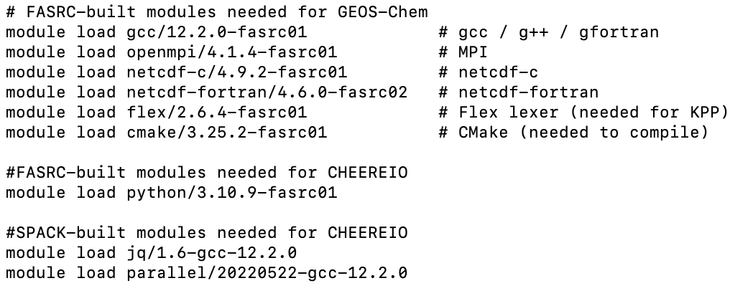
Getting ready: setting up software environments
Environment file
Conda environments
Modify environments > cheereio.env for your system. This will be your GEOS-Chem environment, plus jq/python/parallel
Install cheereio and animation conda environments (environments > cheereio.yaml and > animation.yml)
Command likely will look like the following:
conda env create -f cheereio.yaml
OR
mamba env create -f cheereio.yaml
Modify CondaEnv and AnimationEnv fields in ens_config.json to match installed environment names (cheereio and animation by default).

Slide 21
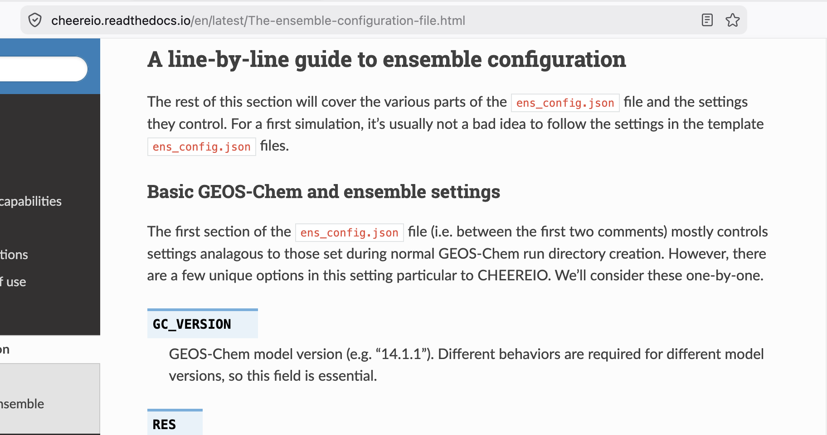
The MOST IMPORTANT PART: editing ens_config.json to define your LETKF problem
All science happens here. Read the documentation first for a line-by-line description.
I recommend starting with one of the supplied templates, using CH₄ if you are doing a long-lived species or NH₃ if short-lived.
Email me at apenderg@oberlin.edu and I can share state-of-the-science configuration files used by myself or other willing groups.

Slide 22
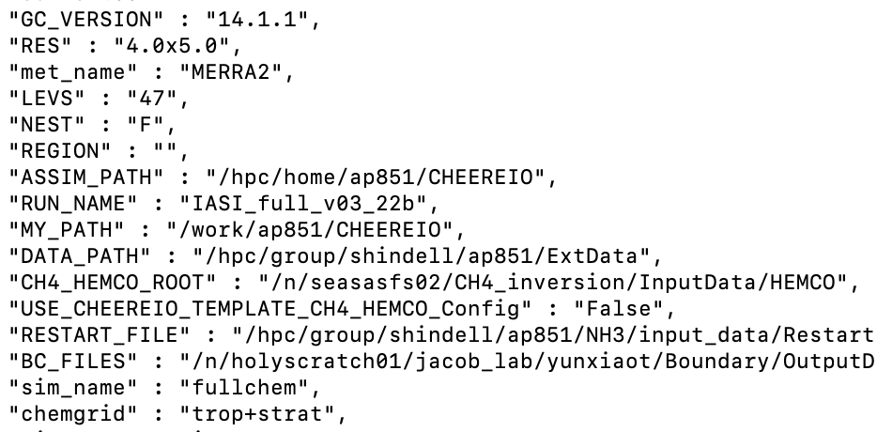
Initialization: defining ensemble settings
Ens_config.json supersedes the normal GEOS-Chem run directory creation process.
At the top of the file, you specify your GEOS-Chem settings.
Notes:
This is because CHEEREIO manipulates the contents of GC run directories, comprising the ensemble, on the fly.
Don’t worry, you can add more minute adjustements by modifying the template run directory

Slide 23
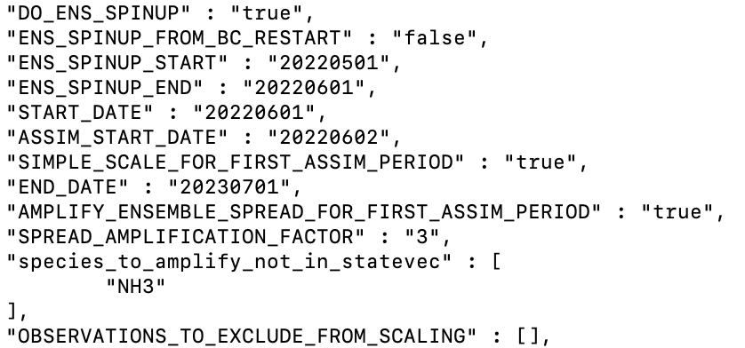
Initialization: how should your LETKF start?
Beyond normal spinup, LETKF requires ensemble spinup — time for emissions differences between ensemble members to be realized in concentration spreads.
You set this up in ens_config.json
First observations
Ensemble spinup
Concentration
(Optional) Scale initial ensemble mean to match observation mean, and/or increase ensemble standard deviation
Ensemble of simulations, all starting from same restart
LETKF begins

Slide 24
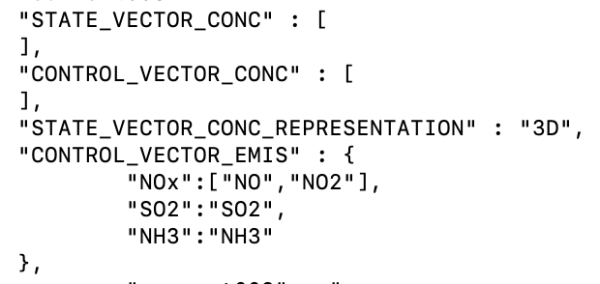
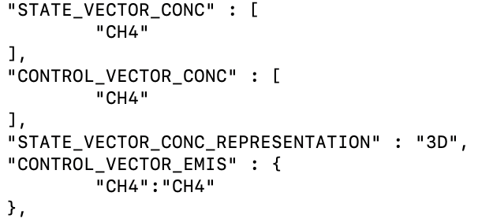
Initialization: define the state vector to be optimized
Define state vectors in ens_config.json
Optimize both CH₄ concentrations and emissions
Joint optimization of NOx, SO2, and NH3 emissions

Slide 25
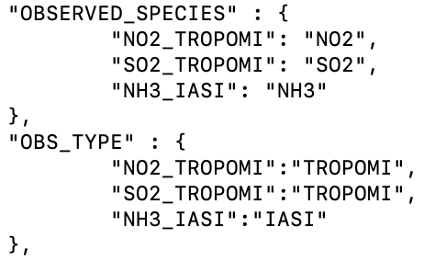
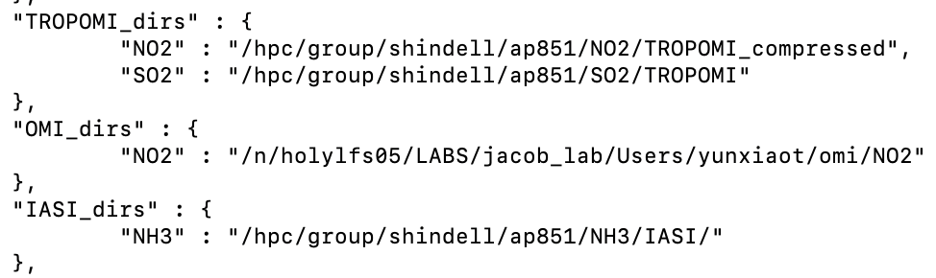
Initialization: tell CHEEREIO how to load the observations you use
We want to jointly assimilate NO_{x}, SO₂, and NH₃
We will constrain emissions using TROPOMI observations of NO₂ and SO₂, and IASI observations of NH₃
CHEEREIO will look for operational products at these file locations

Slide 26
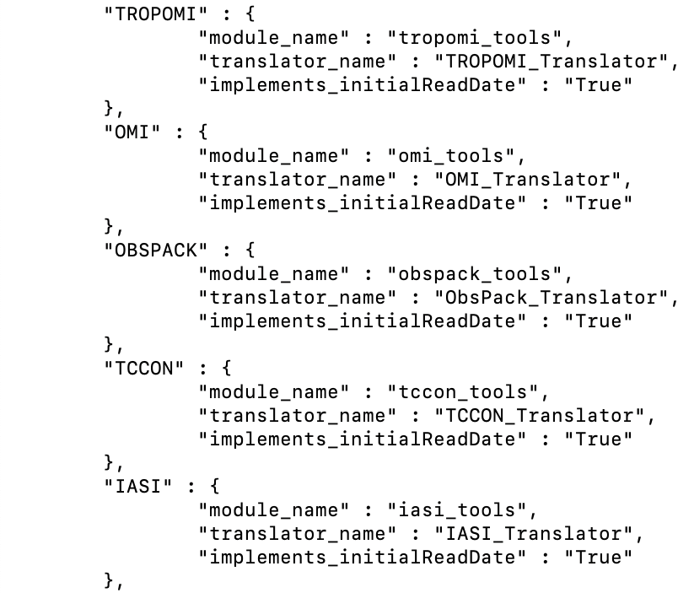

Key data assimilation idea: an observation operator transforms GC output so that it can be compared to an observation
operators.json
Satellites get e.g. a column mixing ratio with varying sensitivities
The OBS_TYPE argument tells CHEEREIO which observation operator to use to load your observations
GEOS-Chem output is on a grid

Slide 27
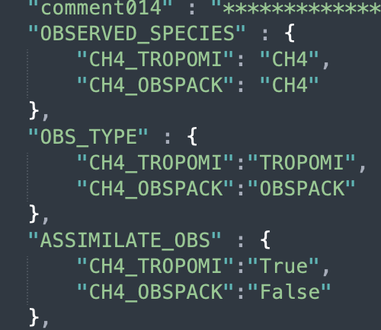

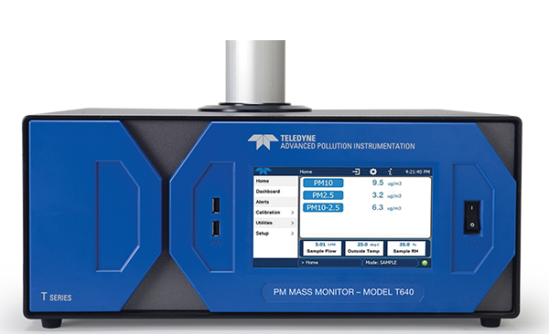
Initialization: tell CHEEREIO how to load the observations you use
Within the configuration file…
…turn on two observers of one species (CH₄)…
…turn on TROPOMI for LETKF updates
TROPOMI
Surface
…but use ObsPack as an independent validation set (no assimilation)
Notes:
What’s great about this is that any CHEEREIO observation operator can automatically be used to validate a run, no programming required.

Slide 28
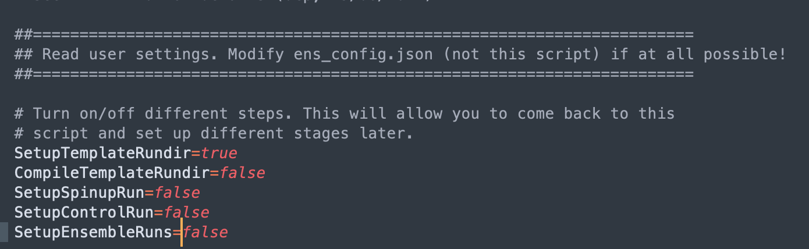
Initialization: deploying the ensemble
Activate cheereio shell environment
In setup_ensemble.sh turn on Template Run directory creation only
Execute script, then navigate to MY_PATH/RUN_NAME
Copy of code used to run ensemble
Ensemble GC run directories
Postprocessed output files
Temporary files, runtime status
Template GC run directory

Slide 29
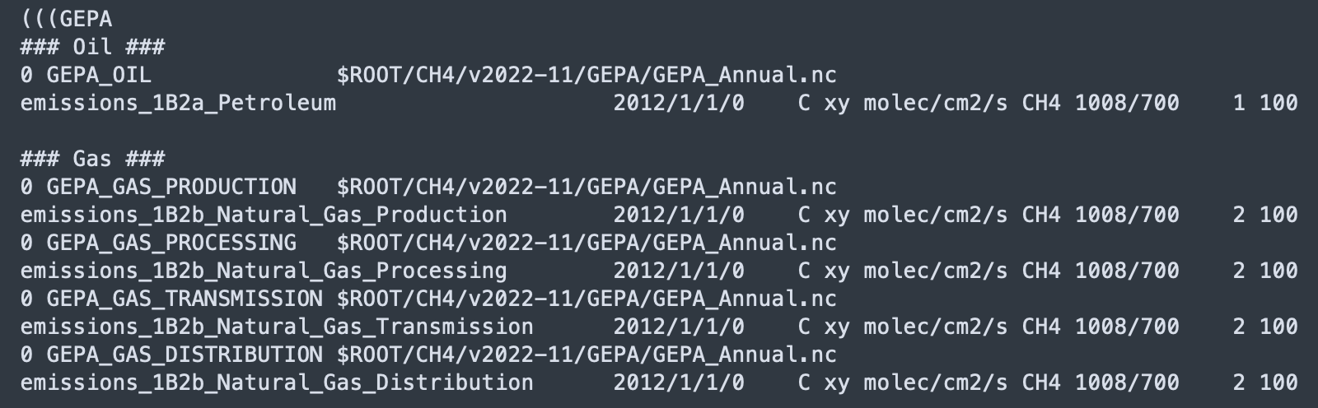
Initialization: deploying the ensemble
Edit template run directory. Settings will be repeated across the ensemble.
CHEEREIO automatically edits HEMCO_Config to link emissions to LETKF scale factors

Slide 30
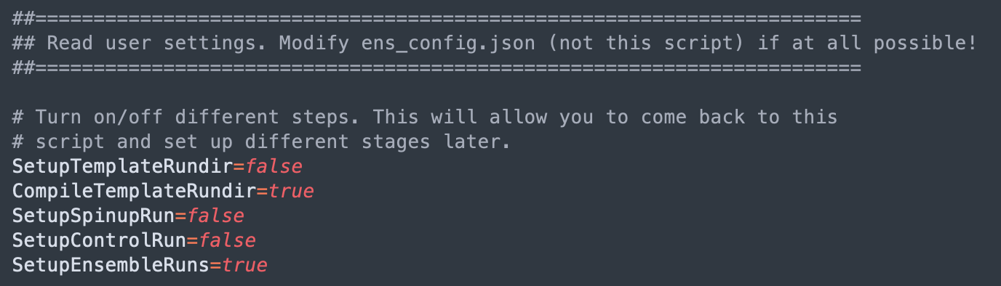
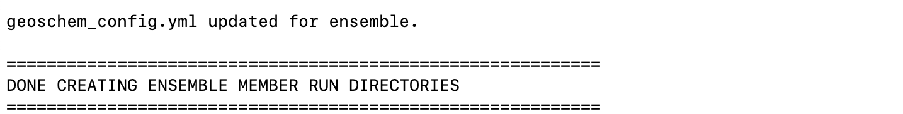
Initialization: deploying the ensemble
Return to setup_ensemble.sh
In setup_ensemble.sh turn off Template Run directory creation and turn on compilation and setup ensemble runs.
Execute. We are now ready to run the ensemble!

Slide 31
Table of contents
Introduction to ensemble data assimilation and CHEEREIO
Installing CHEEREIO and building your first ensemble
Selecting or adding observation operators
Running and debugging CHEEREIO
Postprocessing and data analysis tools

Slide 32
Add new observation operators easily with Python-based inheritance
CHEEREIO is assembled from interchangeable blocks
CHEEREIO provides a template for observation operators…
Observation operators go here

Slide 33
Add new observation operators easily with Python-based inheritance
CHEEREIO is assembled from interchangeable blocks
CHEEREIO provides a template for observation operators…
OMI
TROPOMI
GEMS
Surface
Add your own!
…that then automatically plug in to the CHEEREIO workflow
GEMS inversion ready to go!

Slide 34
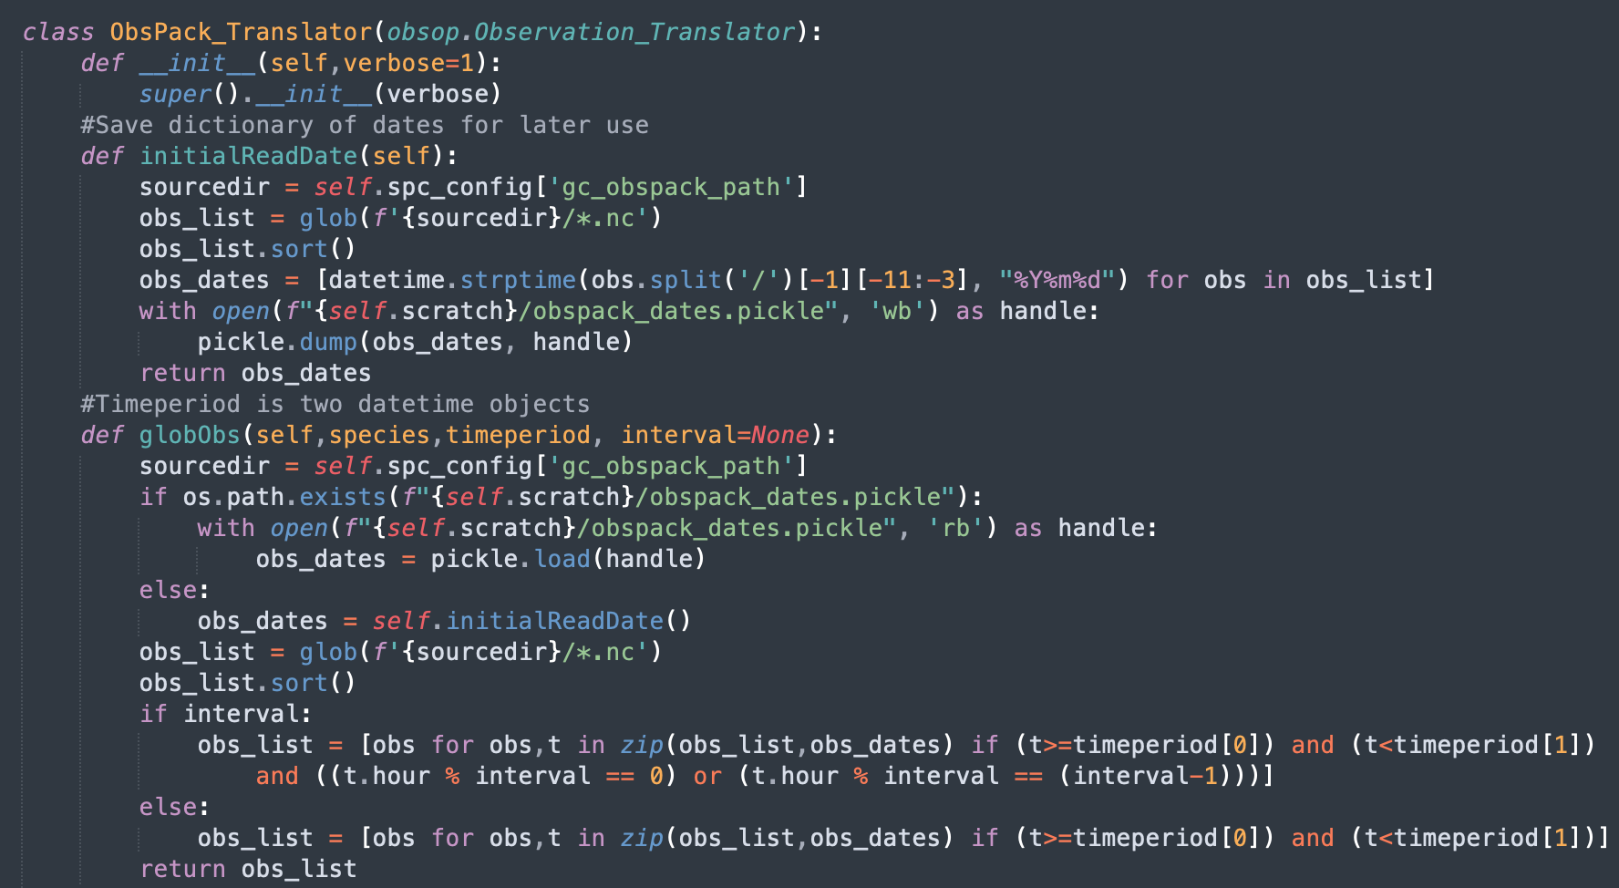
Anatomy of a CHEEREIO observation operator
A Python class which inherits the CHEEREIO Observation Translator parent class — templating
(Optional) Utility method that links observer dates to files — speeds up CHEEREIO
(Optional) Obspack-specific method which finds files with observations between two dates

Slide 35
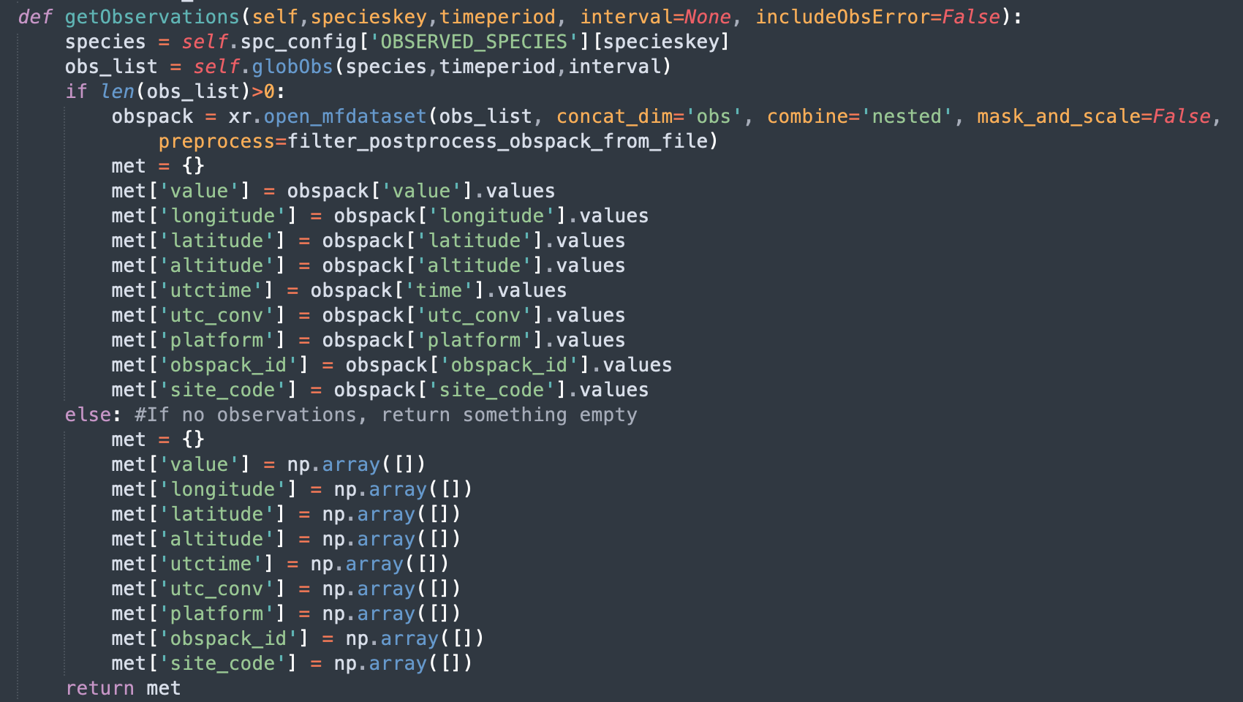
Anatomy of a CHEEREIO observation operator
Function which loads observation data and saves to a standardized dictionary.
Requires species key (references observed species in ens_config) and time period.
MANDATORY FUNCTION 1
CHEEREIO requires 1D arrays for observer value, longitude, latitude, and utctime. All other fields are optional.

Slide 36
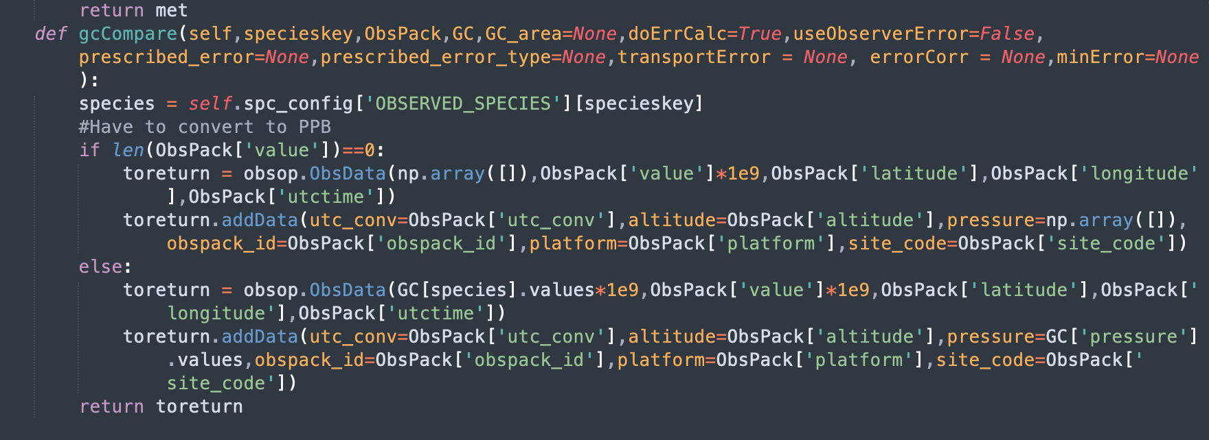
Anatomy of a CHEEREIO observation operator
Core observation operator which compares GEOS-Chem and observations.
MANDATORY FUNCTION 2
Data is returned in ObsData class, which is a list of 1D arrays where GEOS-Chem data are aligned

Slide 37
Table of contents
Introduction to ensemble data assimilation and CHEEREIO
Installing CHEEREIO and building your first ensemble
Selecting or adding observation operators
Running and debugging CHEEREIO
Postprocessing and data analysis tools

Slide 38
Run time: executing the ensemble
(1) Execute nohup bash run_ensspin.sh &
(2) Once all runs complete, execute nohup bash run_ens.sh &

Slide 39
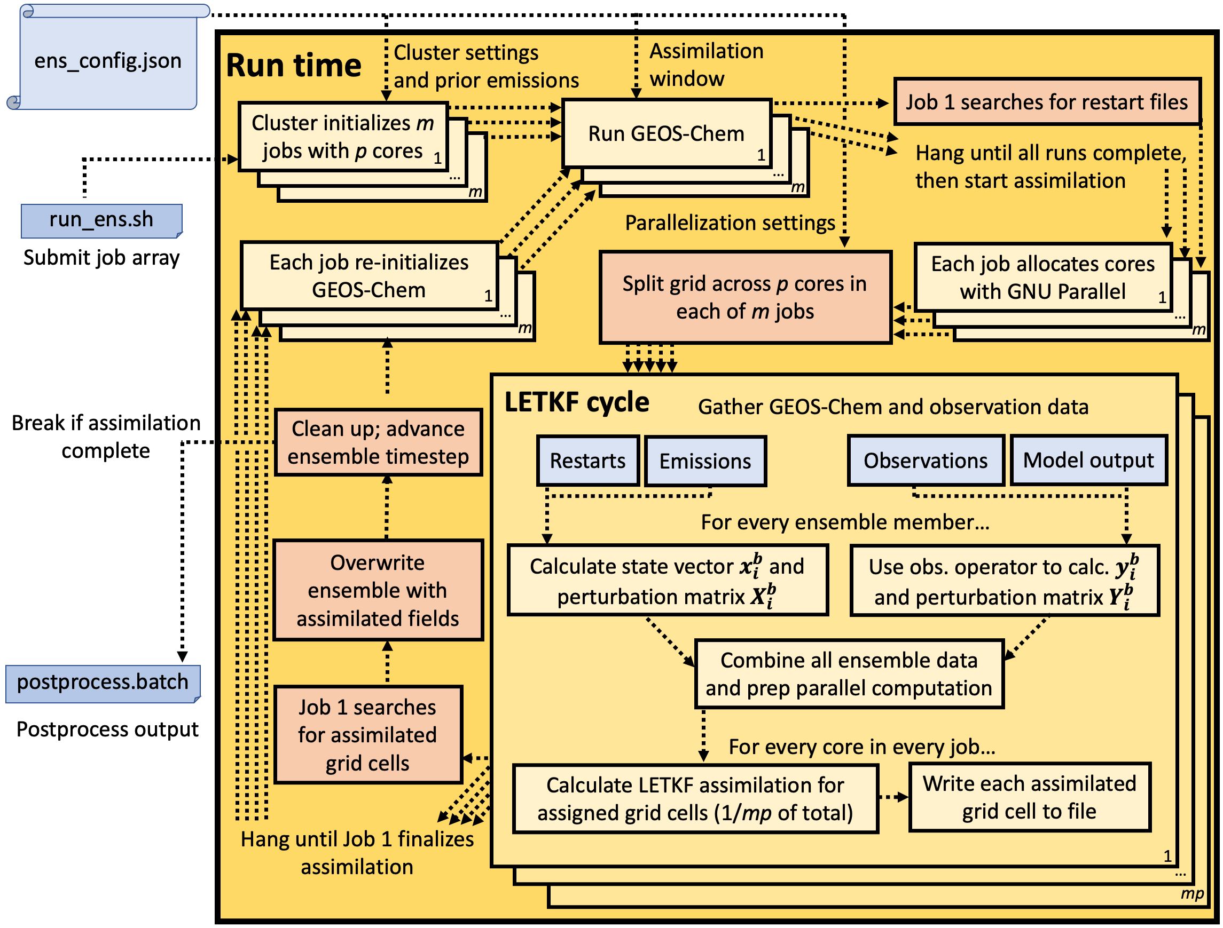
CHEEREIO runtime: behind the scenes

Slide 40
Run time: checking ensemble progress, duplication, and backup restoration

Slide 41
Table of contents
Introduction to ensemble data assimilation and CHEEREIO
Installing CHEEREIO and building your first ensemble
Selecting or adding observation operators
Running and debugging CHEEREIO
Postprocessing and data analysis tools

Slide 42
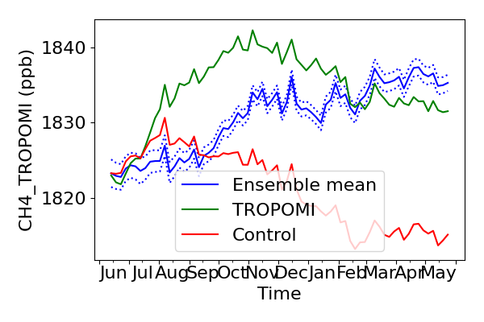
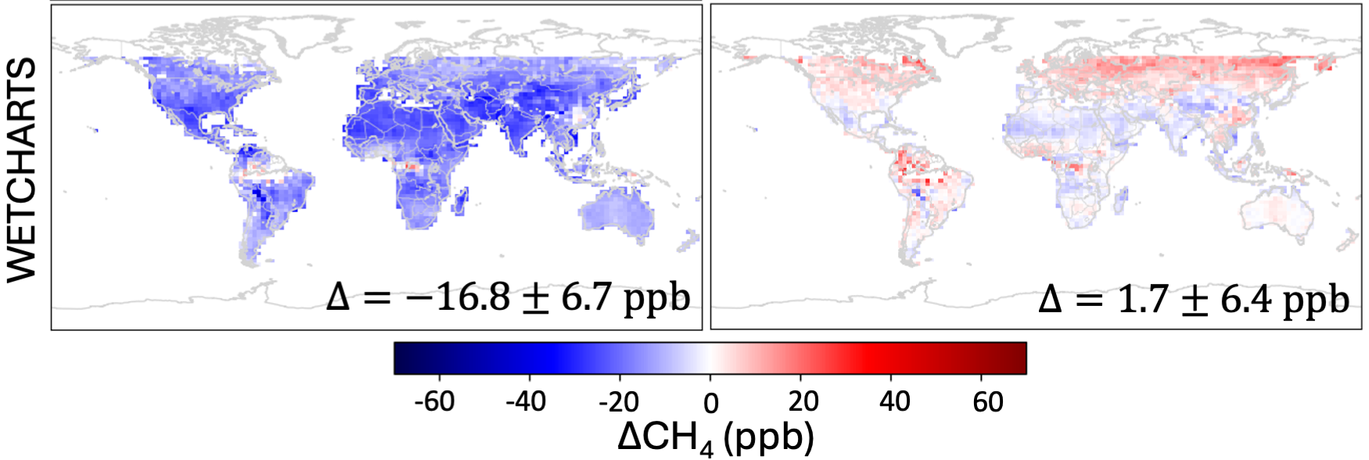
Postprocessing: ensemble snapshots and full postprocessing suite
While CHEEREIO is running
Get super-fast view of ensemble status with snapshot.sh

Slide 43
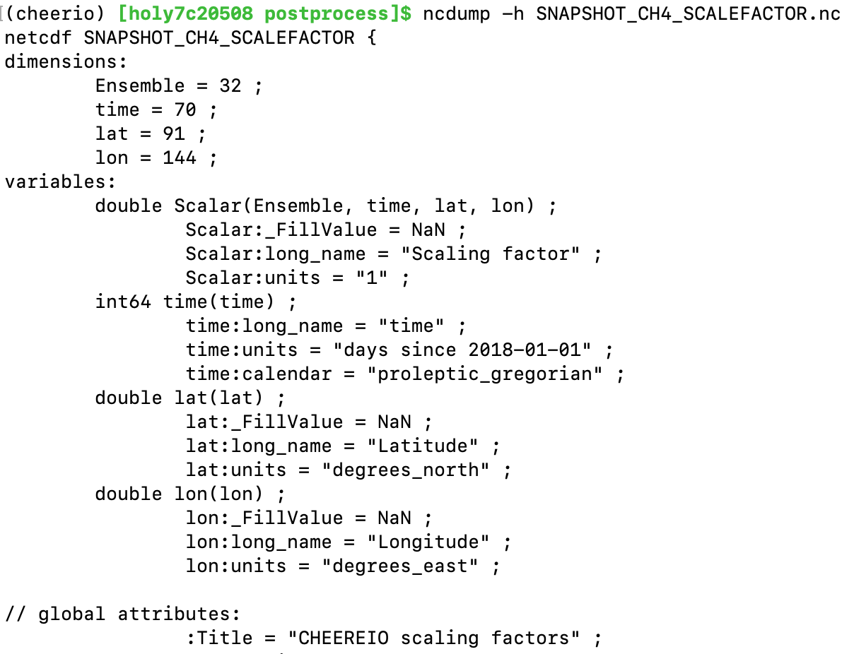
Postprocessing: emissions scaling factors
Hemco output (full emissions, scale factors applied) follows same conventions

Slide 44
Postprocessing: bigY, or observation operator raw output
Entries for every assimilation period

Slide 45
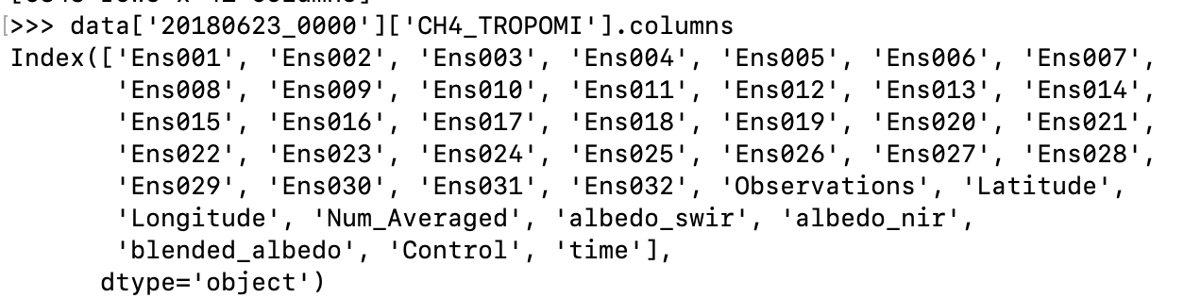
Postprocessing: bigY, or observation operator raw output
For every date, a table of each ensemble mapped to observations, along with geospatial data and metadata

Slide 46
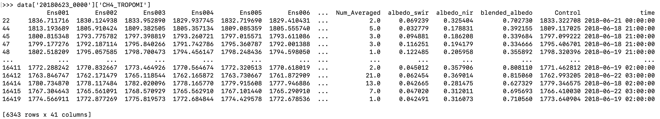
Postprocessing: bigY, or observation operator raw output
For every date, a table of each ensemble mapped to observations, along with geospatial data and metadata
…

Slide 47
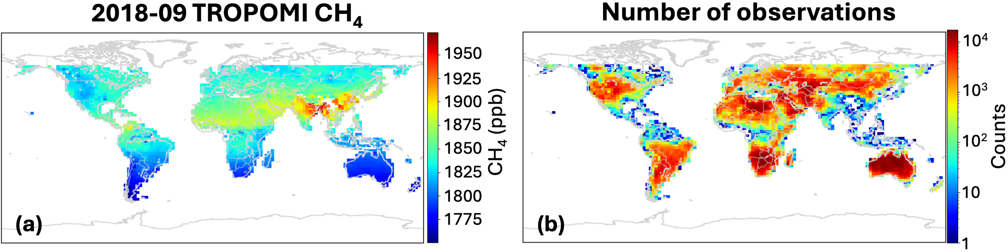
Postprocessing: bigY gridded for plotting
…
GC ensemble mean, mapped to operator, gridded (time,lat,lon)
Observations, averaged to GC grid (time,lat,lon)
Control GC simulation, no assimilation (time,lat,lon)

Slide 48
A hopeful promise and a dire warning
But those first results will be wrong, scientifically. Many adjustments are necessary before errors reduce in a reasonable way.
I am happy to help; send diagnostic plots to apenderg@Oberlin.edu and I can recommend ens_config.json adjustments
Simulate
Observe
Optimize
You can get your first results very fast, from the latest GEOS-Chem or your own custom modification of the code. No new Fortran.

Slide 49
Useful resources
CHEEREIO paper: https://gmd.copernicus.org/articles/16/4793/2023/
CHEEREIO website: https://cheere.io
CHEEREIO documentation: https://cheereio.readthedocs.io
Details on GEOS-Chem (and CHEEREIO) software requirements: https://geos-chem.readthedocs.io/en/stable/getting-started/system-req-soft.html
I am here to help! Ask any questions at https://github.com/drewpendergrass/CHEEREIO/issues (preferred) or by email: apenderg@oberlin.edu

