Slide 1
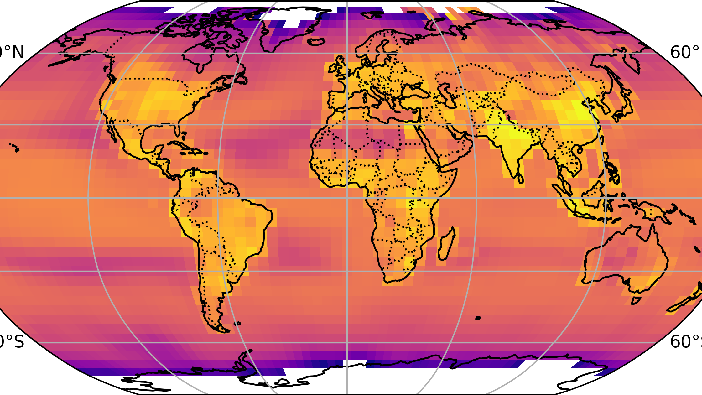


Drivers of 2013–2024 global ammonia emissions trends: implications for future climate change
With Drew Shindell, Lieven Clarisse, Martin Van Damme, Maureen Beaudor, Jize Jiang, and Shixian Zhai
Twelfth International GEOS-Chem Meeting
St. Louis, MO
Drew Pendergrass
Postdoctoral associate
Duke University
June 9, 2026

Slide 2
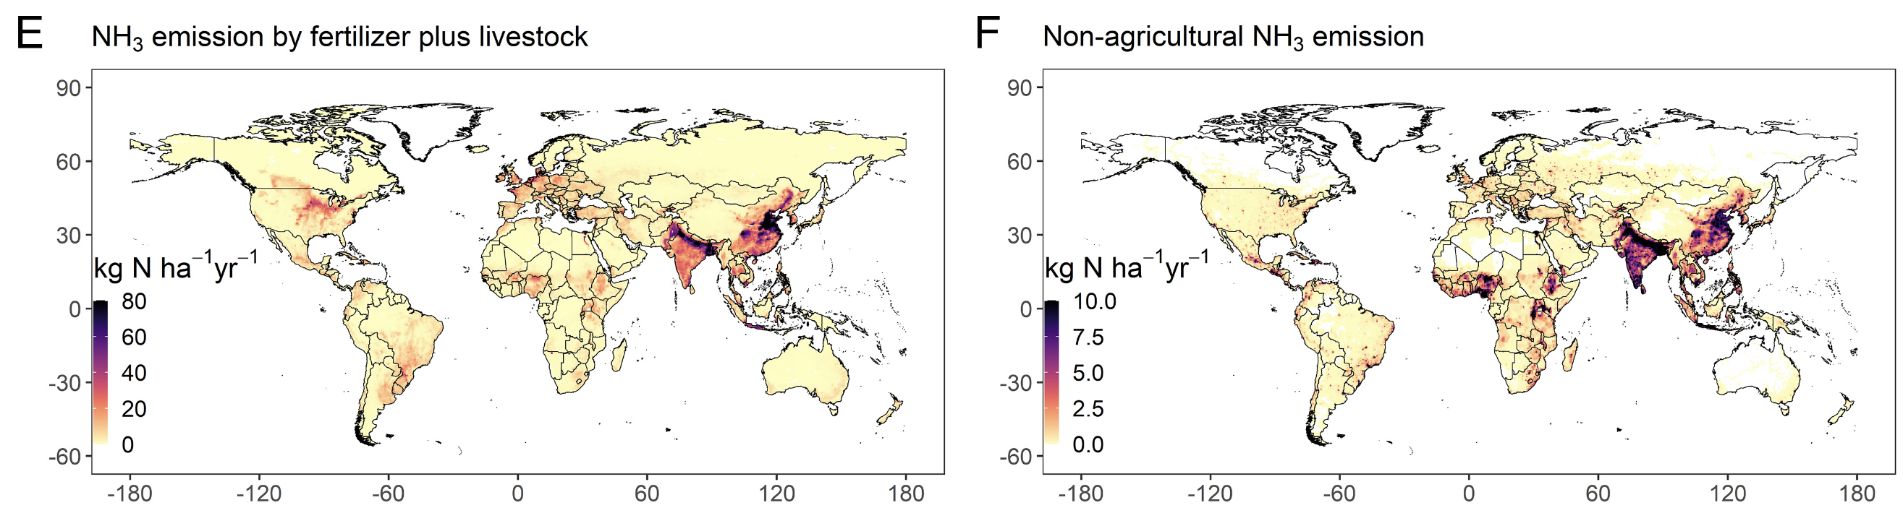
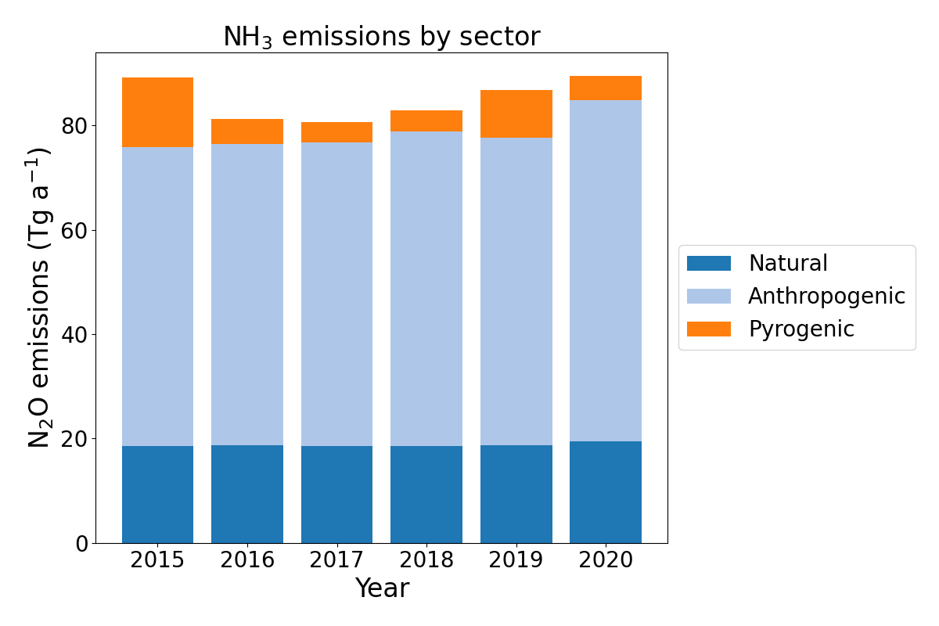
Ammonia has natural, industrial, and agricultural sources
Agriculture (livestock plus crops)
NH₃ emissions (Tg a⁻¹)
Oceans, soils, and animals (especially birds)
Non-agricultural anthropogenic
This work, in prep
Liu et al., 2022 (2010 emissions)
Notes:
Highlight the colorbar axis

Slide 3
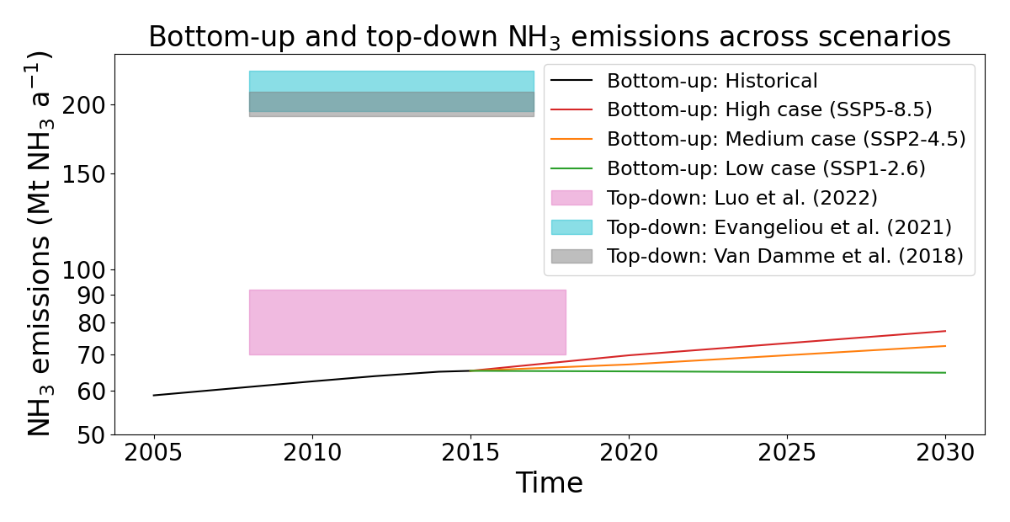
The literature disagrees about how much ammonia is emitted globally
NH₃ columns, July 2019

Slide 4
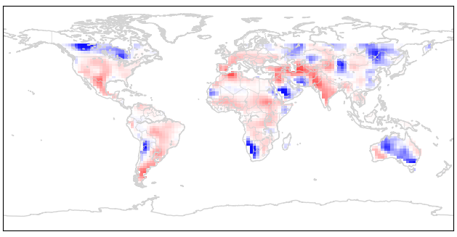
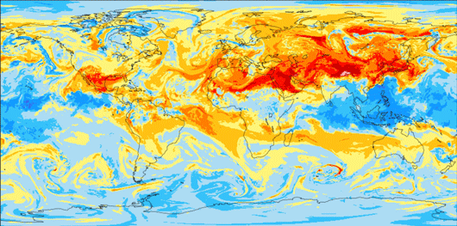
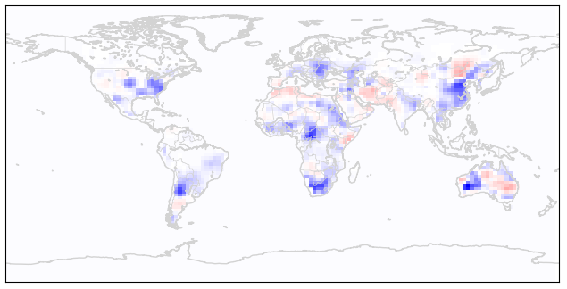

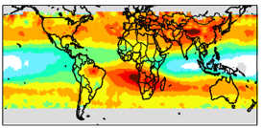
How LETKF can estimate emissions of any species
…
…
Run an atmospheric model for each
emission field
Generate n perturbations
to initial emissions map
Generate n simulated 3D atmospheres, each reflecting different emissions
Apply observation operators (e.g. satellite averaging kernels)
…
Compare simulated observations to actual observations
…
Use ensemble spread to approximate prior error covariance matrix
Specify or calculate observational error covariance matrix
https://cheere.io
Pendergrass et al., 2023

Slide 5

How LETKF can estimate emissions of any species
…
…
Run an atmospheric model for each
emission field
Weighting by covariance matrices, calculate optimal posterior emissions and/or concentrations
Generate n simulated 3D atmospheres, each reflecting different emissions
Repeat
Apply observation operators (e.g. satellite averaging kernels)
…
Compare simulated observations to actual observations
…
Use ensemble spread to approximate prior error covariance matrix
Specify or calculate observational error covariance matrix
https://cheere.io
Pendergrass et al., 2023

Slide 6
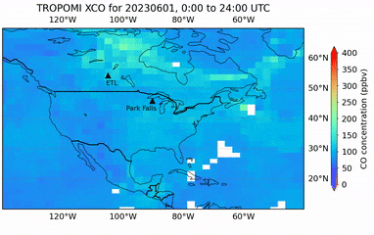
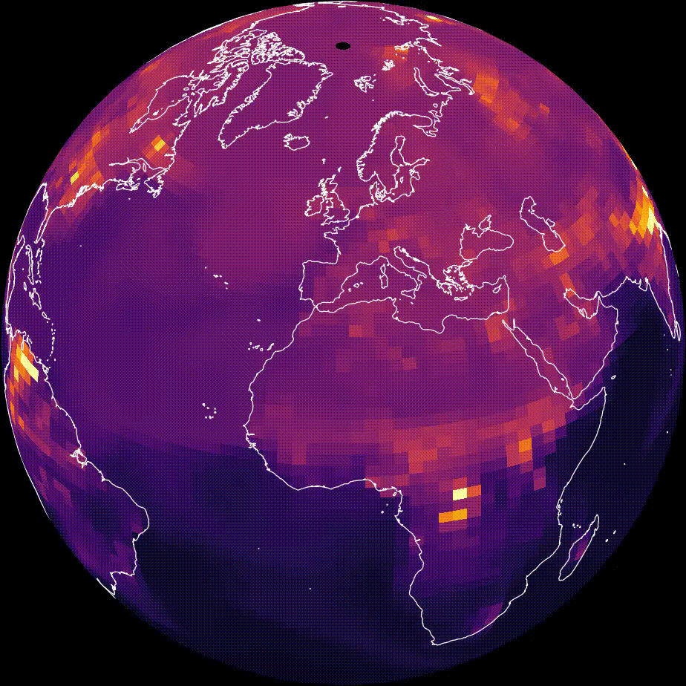
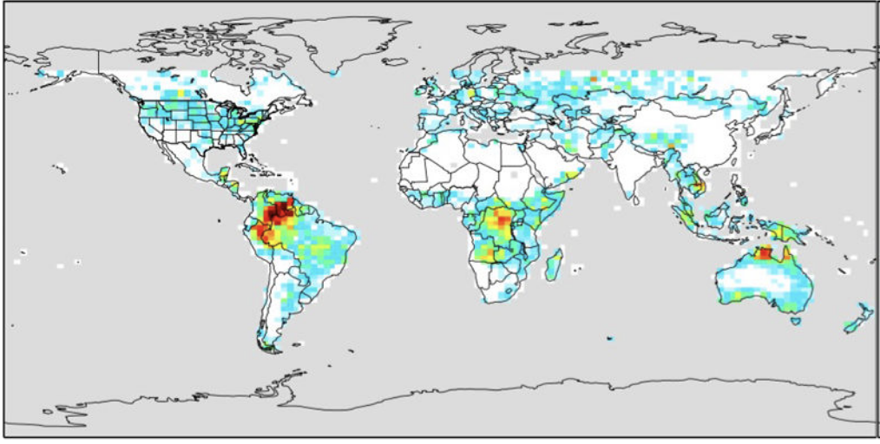
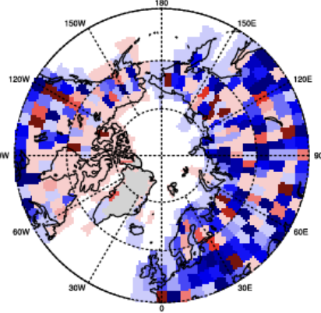
CHEEREIO can…
Invert CH₄ emissions at global and regional scales (several groups)
Constrain biomass burning with TROPOMI CO (Sina Voshtani and Dylan Jones, Toronto and ECCC)
Serve as the Pepsi to the IMI/ICI’s Coke
Invert CrIS VOCs (Dylan Millet and Kelley Wells, UMN)
Invert CO₂ fluxes (Yiming Xu and Qianlai Zhuang, Purdue)
https://cheere.io

Slide 7
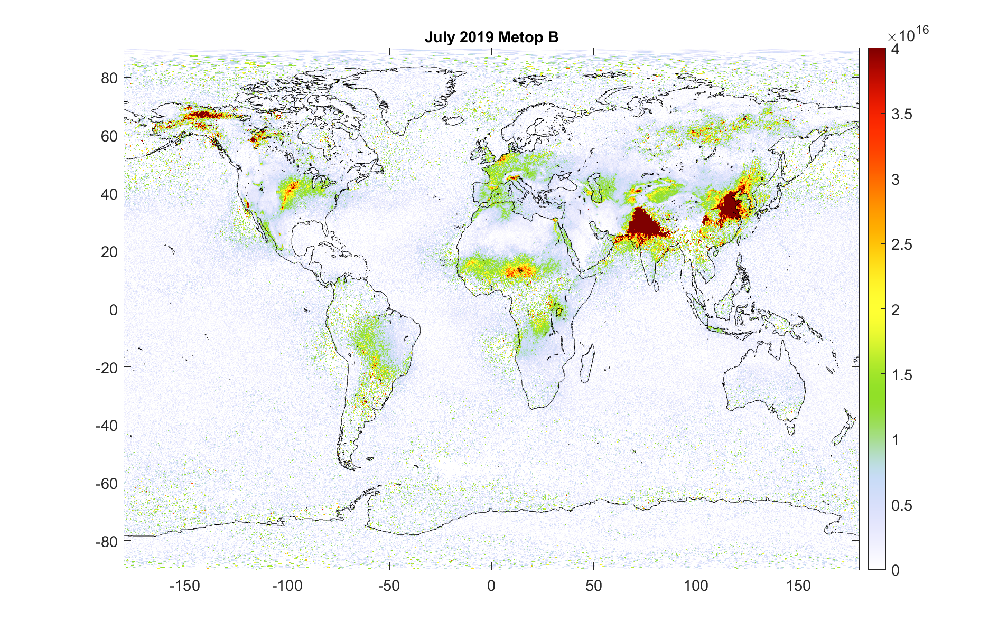
We can constrain 2013-present ammonia emissions with satellite data from the IASI instrument
IASI NH₃ mean for July 2019

Slide 8
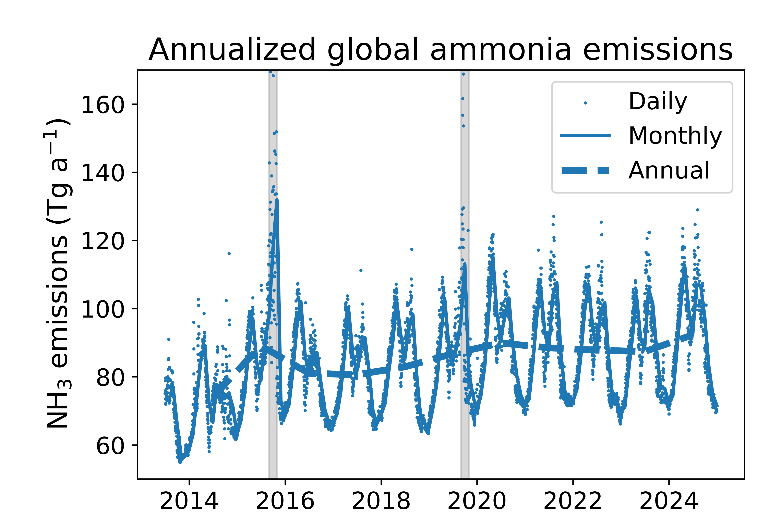
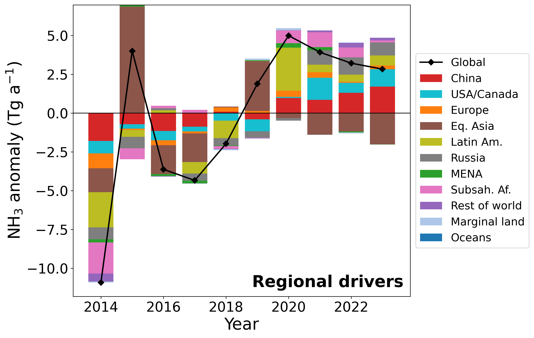
Ammonia emissions are trending upward, surging in El Niño years because of fires
Regional drivers of global ammonia emission anomalies
This work, in prep

Slide 9
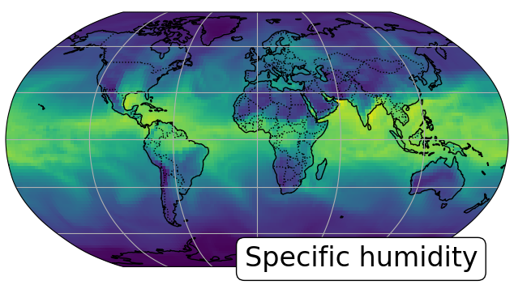
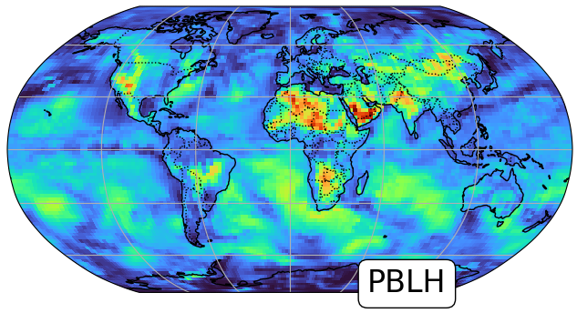
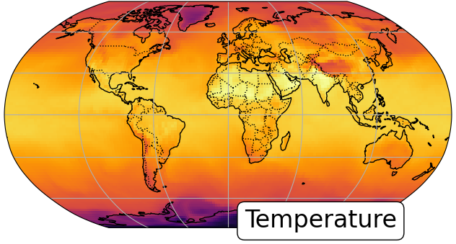
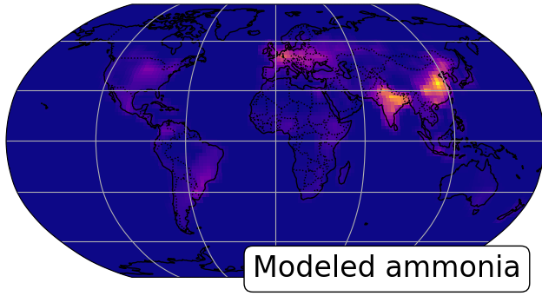
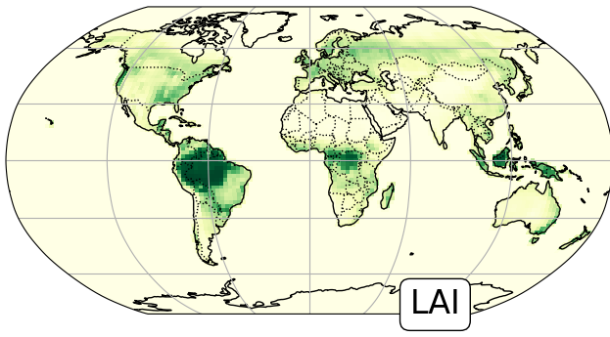
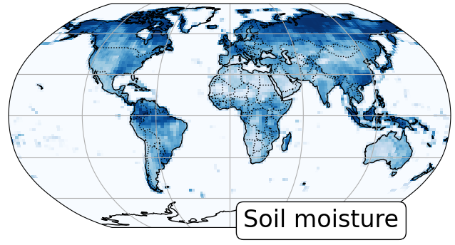
To diagnose which sectors drive emissions, we use a bootstrapping approach powered by machine learning
E.g., keep GFED as is
RF
Meteorological
Train random forest
Monte Carlo shuffle most predictors across years, within season
Withhold 1-2 variables to follow historical pattern
…
RF
RF
RF
RF
RF
RF
Terrain, soil, vegetation
Bootstrap and repeat thousands of times
…
Average is fire-driven trend
Daily 2013-2024 NH₃ emissions
plus GFED fires, OMI NO_{x}/SO₂, UN FAO fertilizer application and livestock counts
Repeat the procedure to partition all variables
Following Grange et. al, 2018

Slide 10
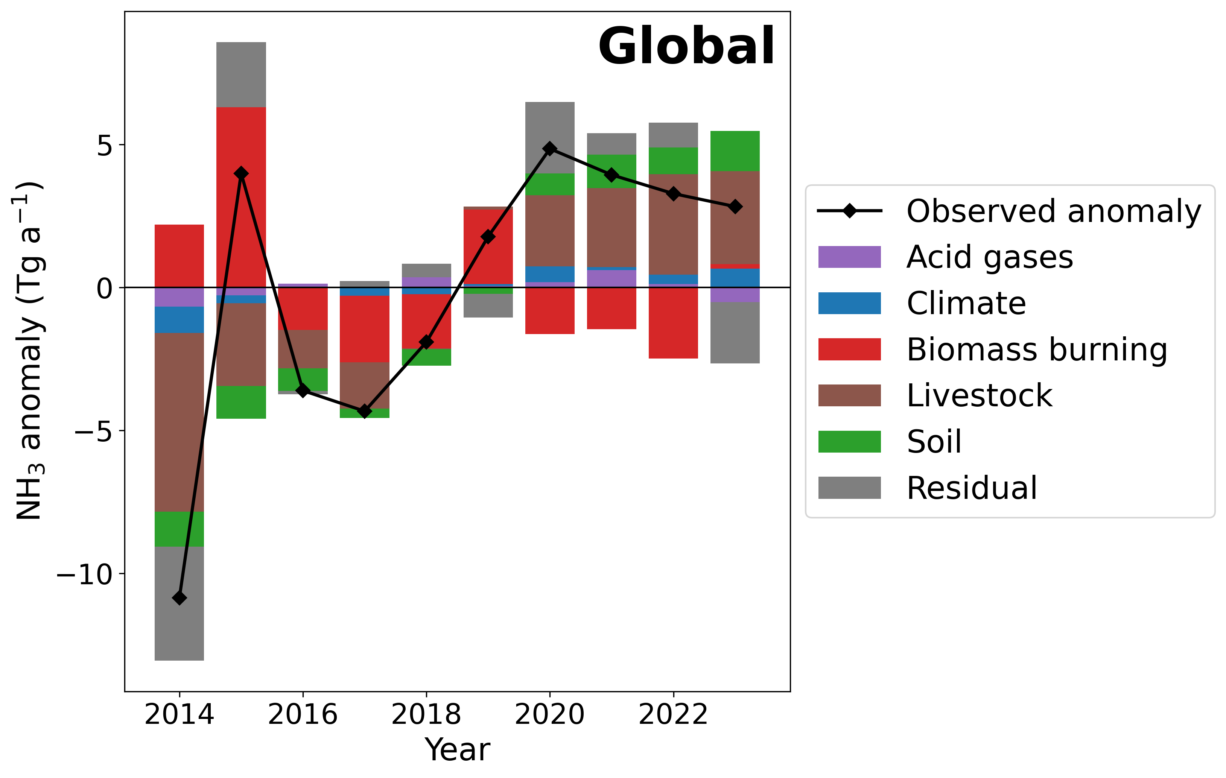
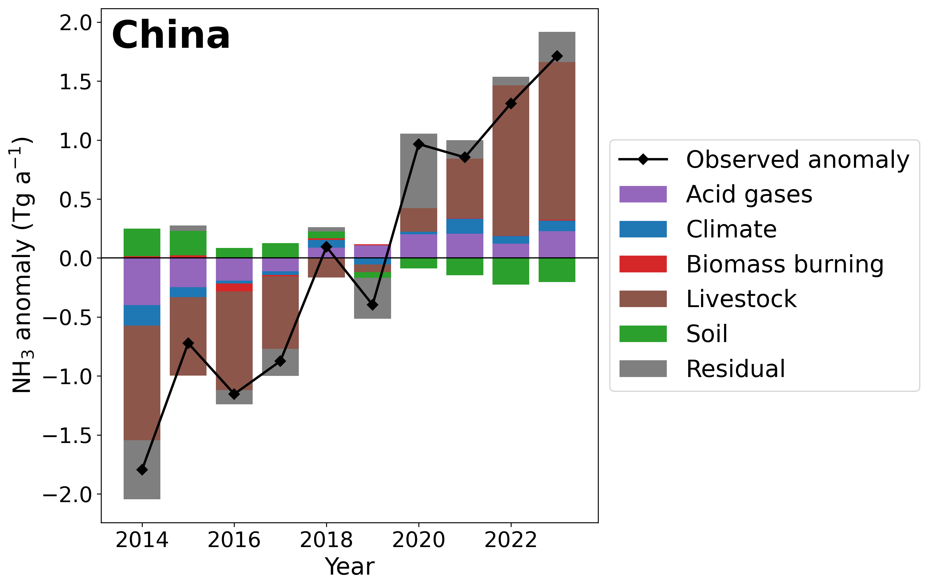
While fires drive global interannual variability, increases in livestock and soil emissions drive long-term trend
This work, in prep

Slide 11
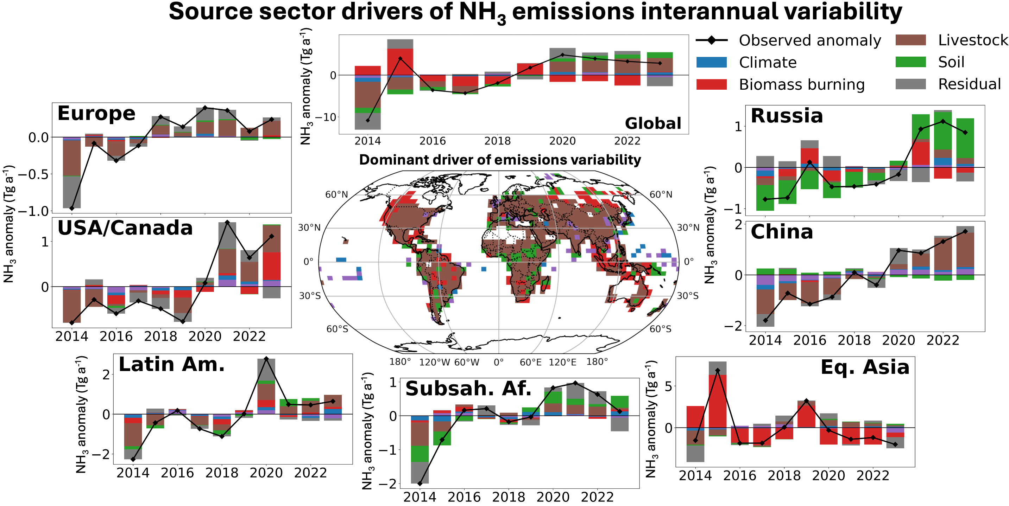
Dominant sectoral drivers of change are regionally varied
This work, in prep

Slide 12
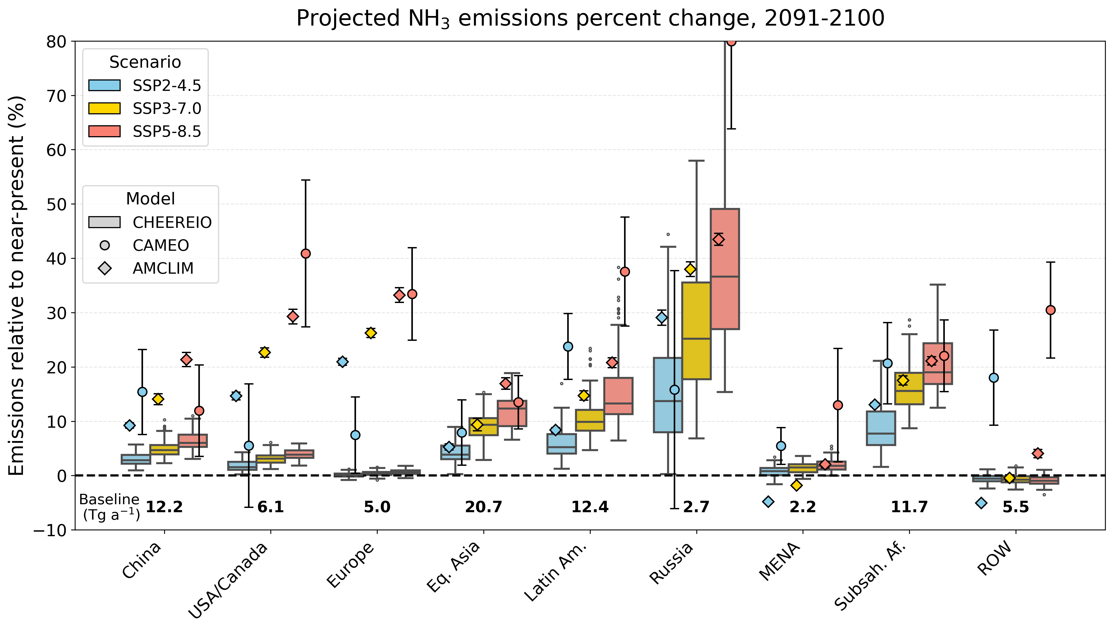
Climate change increases our data-driven ammonia emissions, consistent with two mechanistic land models
This work, in prep

Slide 13
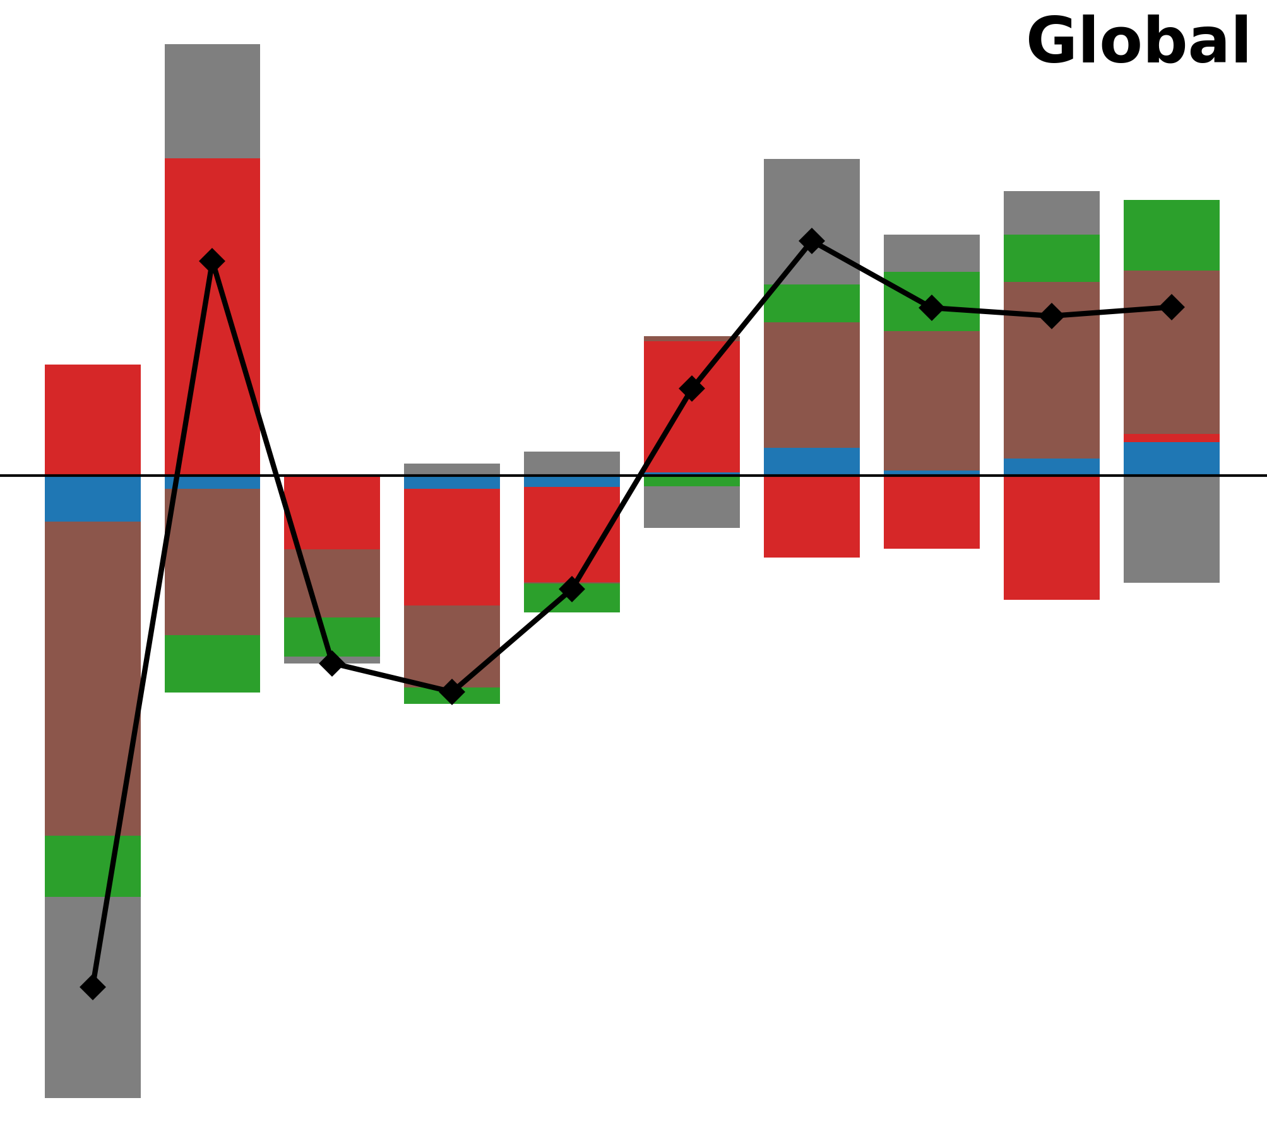
Take-aways
While fires drive interannual variability, agriculture drives long-term increase
This work
In many regions, climate change will increase NH₃ emissions up to 20% by 2100, consistent with physical models
Global NH₃ emissions are probably in the 80-90 Tg a⁻¹ range

Slide 14
Thank you!

